Slide 1
Motors 101
Tom Milnes
BAA Team 2199 Representative
Principal Mathematician JHU/APL
Notes:
Introduction by Mr. Milnes

Slide 2
Why Use Electrical Motors?
High Torque or Speed Rotational Motion Is Needed
Low Torque, Speed, with finite rotation can achieved with Servos
Variable speed / force linear motion is needed over long distances (using cord or chain)
Two position linear motion better achieved with pneumatics over achievable ranges
Motion prevention is also better done with pneumatics
Pneumatic device pins a manipulator part into place
Notes:
Matt

Slide 3
What is an Electrical Motor?
Device which converts Electrical Power to Mechanical Rotational Power
Notes:
Matt

Slide 4
What is Power?
Power is the rate of Energy production
Power = Energy / Time
Notes:
Matt

Slide 5
What is Energy?
Physics Inspired English Definition
Energy is required to do Work
Energy Sources
Battery, Stretched Spring, Gasoline, Moving Object, Object at Height
Can be converted from / to various forms
Total is conserved
But some is usually converted to useless forms such as heat
Notes:
Abi gives as Drive System / Chassis lead

Slide 6
What is Work?
Unlike say - a homework set – for physical tasks work has a precise definition
Linear Motion
The product of distance moved times the opposing force
Work = Force x Distance (pound – feet, Newton-meters)
Lifting Task = Object Weight x Distance Moved
Rotational Motion
The product of angle rotated times the opposing torque
Work = Torque x Angle (pound – feet, Newton-meters)
Notes:
Abi

Slide 7
What is Power?
Power is required to Work Quickly
Precise definitions for Physical Tasks
Linear Motion
The product of velocity moved times the opposing force
Power = Force x Velocity (pound – feet/s, Newton-meter/s)
Lifting Task = Object Weight x Velocity
Rotational Motion
The product of angular rate times the opposing torque
Power = Torque x Angular Speed (pound-feet/s, Newton-meter/s or pound – feet x rpm, Newton-meter x rpm)
Notes:
Abi

Slide 8
Power
Power is conserved in a linked or closed loop system but not always in useful form.
Ratio of Output Power / Input Power is called efficiency – varies from 0 to 1
Heat loss is a double whammy
For Electrical Motors Mechanical Power is:
Torque x Angular Speed = τω

Slide 9
DC Motor Characteristics
Linear Relation between Torque and Angular Speed
Maximum
Speed
Angular Speed (rpm)
Maximum
Torque
0
Torque (oz-in)
Notes:
Mikey

Slide 10
Power
Power is Torque x Angular Speed
Maximum
Speed
Max Power
Angular Speed (rpm)
Power (Watts)
Maximum
Torque
0
Torque (oz-in)
Notes:
Elizabeth

Slide 11
Current Draw (Amperage)
Current draw is proportional to torque
Maximum
Speed
Max Power
Current (Amps)
Power (Watts)
Angular Speed (rpm)
Maximum
Current
Maximum
Torque
0
Torque (oz-in)
Notes:
Elizabeth

Slide 12
Motor Limitations
In many cases motors are current limited with respect to maximum achievable power
See Example Next
Max torque / Max current is bad for motors!
Circuit breakers aren’t fast enough to prevent motor destruction – they are designed to keep wiring from burning!!
“Magic Blue Smoke” results
Always protect against this!
Time limit a motor that runs into a mechanical stop
Place a detector to stop / reverse the motor before a mechanical stop

Slide 13
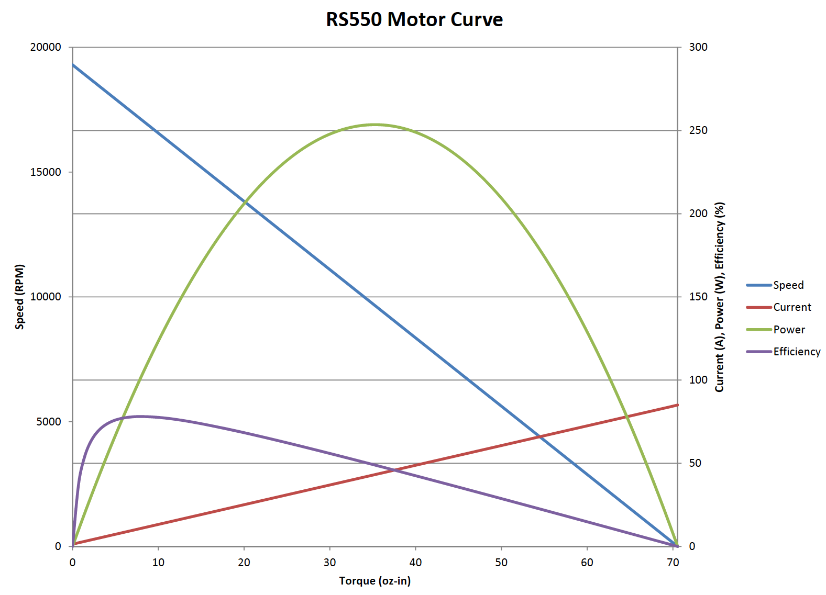
Practical Example
Banebots
40 Amp
Circuit
Breaker
40 Amp
Breaker
Notes:
Elizabeth

Slide 14
Using Motors
Electrical Motors are intrinsically high speed / low torque devices – not highly useful out of the box
Pulleys and Belts, Gears, Sprockets and Chain required to increase torque / lower speed for real utility
Notes:
Connor

Slide 15
Pulley Example
2nd Pulley
Attached to Device
1st Pulley
Attached to Motor
v
r₁
Notes:
Connor

Slide 16
Pulley Example
Output Pulley
Attached to Device
1st Pulley
Attached to Motor
v

Slide 17
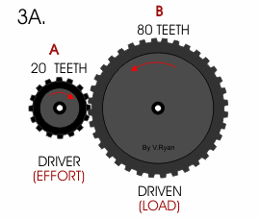
Gear Example
Gear 2
Gear 1
Reversal of Direction
Notes:
Connor

Slide 18
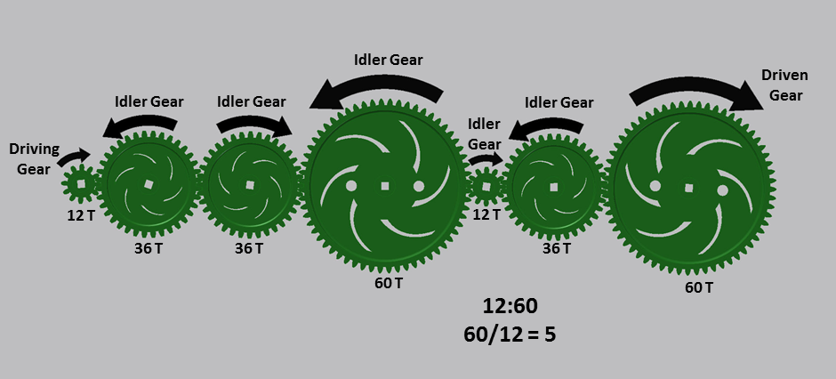
Gears In Series

Slide 19
Gears In Series
Appears highly difficult but generalizing the original gear example for any two gears “n” and “n+1” we have
Applied recursively starting with gears 1 and 2 we have

Slide 20
Gears In Series
Don’t Effect Gear Ratio Calculations

Slide 21
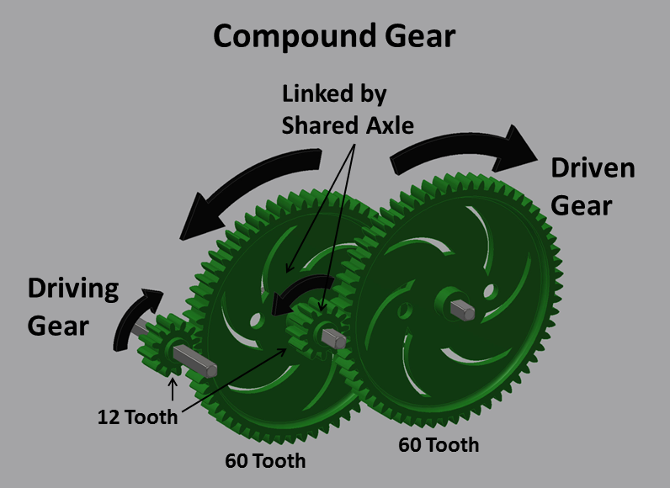
Gears in Parallel – Compound Gears
Individual Gear
Ratios Multiply
In Compound Gears
5:1
5:1
Overall Ratio is 5:1 x 5:1 = 25:1

Slide 22
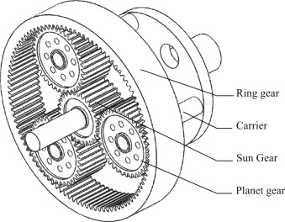
Planetary Gears
Planet Gears are Idler Gears
In a Planetary Gearbox

Slide 23
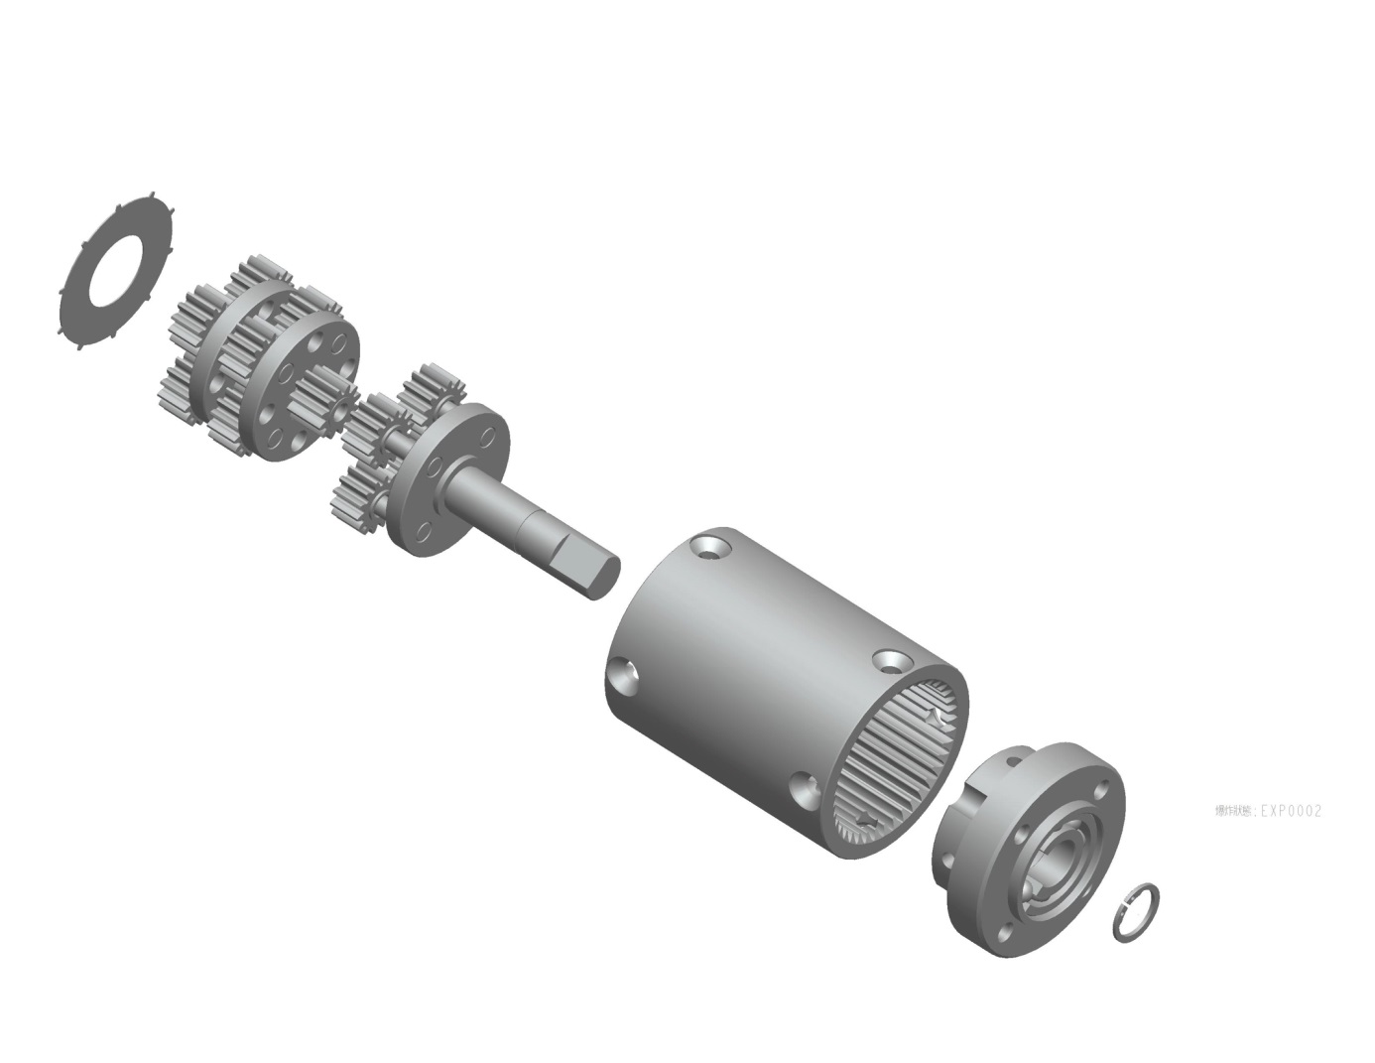
Planetary Gear Stages
Motor
Input
3-Stage Gearbox
Each Stage N:1
Total N³:1
N:1
N:1
N:1
Output Shaft
Ring Gear
Very Compact!!!

Slide 24
Motors – Power is Key!
The most important thing to look for in a motor is its overall Power capability!
Then look at torque and speed individually
Use of gears, chains, belts will allow you to obtain the desired speed / torque combination for your application.

Slide 25
2017 Motors Ranked by Power
Brand | Type | Order # | Max Power (Watts) | Stall Torque (oz-in) | Free Speed (rpm)
RS775 | Pro | 217-4347 | 347.83 | 100.54 | 18700
Many | CIM | Varies | 337.34 | 343.40 | 5310
BaneBots | RS-775 | M7-RS775-18 | 266.79 | 110.93 | 13000
BaneBots | RS-550 | M5-RS550-12 | 245.83 | 68.85 | 19300
VEX | mini-CIM | 217-3371 | 227.40 | 198.26 | 6200
AndyMark | 9015 | am-0912 | 179.49 | 60.64 | 16000
VEX | BAG | 217-3351 | 146.71 | 56.64 | 14000
AndyMark | RS775-125 | am-2194 | 36.91 | 35.00 | 5700
AndyMark | RS775-5 | am-2161 | 36.91 | 35.00 | 5700
AndyMark | Snow Blower | am-2235 | 29.60 | 1600.00 | 100
Denso | Window | 5-163800-RC1 | 21.81 | 1309.91 | 90
Denso | Throttle | AE235100-0160 | 18.04 | 18.40 | 5300
AndyMark | NeveRest | am-3104 | 14.00 | 8.75 | 6600
Bosch | Seat Motor | 6004 RAE 194-06 | 13.83 | 3115.46 | 24

Slide 26
2017 Motors Ranked by Type
Brand | Type | Order # | Max Power (Watts) | Stall Torque (oz-in) | Free Speed (rpm)
RS775 | Pro | 217-4347 | 347.83 | 100.54 | 18700
Many | CIM | Varies | 337.34 | 343.40 | 5310
BaneBots | RS-775 | M7-RS775-18 | 266.79 | 110.93 | 13000
BaneBots | RS-550 | M5-RS550-12 | 245.83 | 68.85 | 19300
VEX | mini-CIM | 217-3371 | 227.40 | 198.26 | 6200
AndyMark | 9015 | am-0912 | 179.49 | 60.64 | 16000
VEX | BAG | 217-3351 | 146.71 | 56.64 | 14000
AndyMark | RS775-125 | am-2194 | 36.91 | 35.00 | 5700
AndyMark | RS775-5 | am-2161 | 36.91 | 35.00 | 5700
AndyMark | Snow Blower | am-2235 | 29.60 | 1600.00 | 100
Denso | Window | 5-163800-RC1 | 21.81 | 1309.91 | 90
Denso | Throttle | AE235100-0160 | 18.04 | 18.40 | 5300
AndyMark | NeveRest | am-3104 | 14.00 | 8.75 | 6600
Bosch | Seat Motor | 6004 RAE 194-06 | 13.83 | 3115.46 | 24

Slide 27
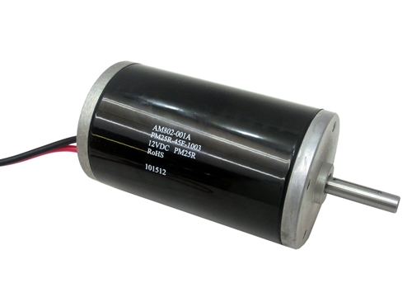
Drive Motors
CIM Motors
Heavy duty sealed bearing motor
Can take continuous use and varying acceleration
Also physically heavy
Best mounted low in your robot for stability
Use at least 4 in your Drive System
Otherwise you will be pushed around by other robots
Use 5th or 6th CIM for high power tasks
2015 “Recycle Rush” – Tote / Garbage Can Lifter
2016 “Stronghold” – Climbing Motor
2017 “Steamworks” – Climbing Motor

Slide 28
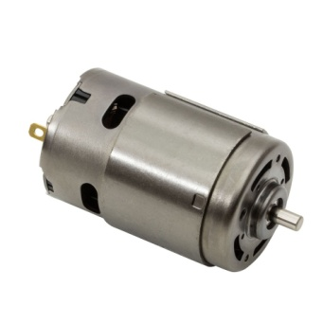
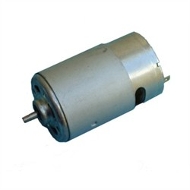
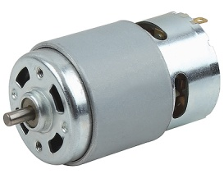
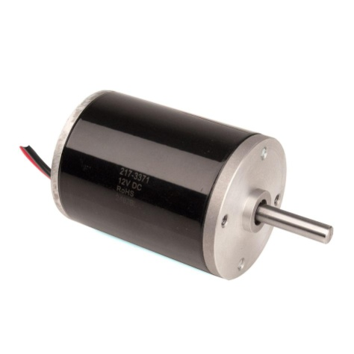
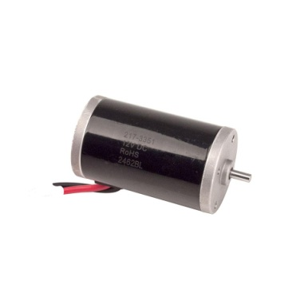
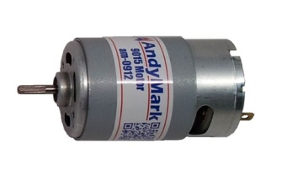
High Power Motors
Banebots 775-18
Banebots 550
VexPro 775 Pro
347 Watts
273 Watts
254 Watts
Bag Motor
Mini-CIM
Andy Mark 0912
179 Watts
149 Watts
229 Watts
Use for high torque or high speed manipulators!!

Slide 29
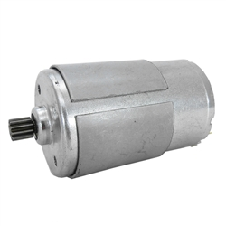
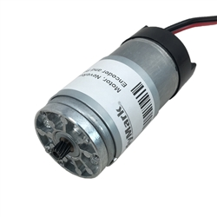
Low Power Motors Highly Useful
RS-775-125 – am-2194
RS-775-5 – am-2161
NeveRest Motor
AndyMark’s principal
FTC motor
Very low power,
precision movement
Numerous Gearboxes,
Encoders And Mounting Kits
From AndyMark
Numerous Gearboxes,
Encoder And Mounting Kit
From AndyMark
For low power use (such as
Precision pointing)

Slide 30
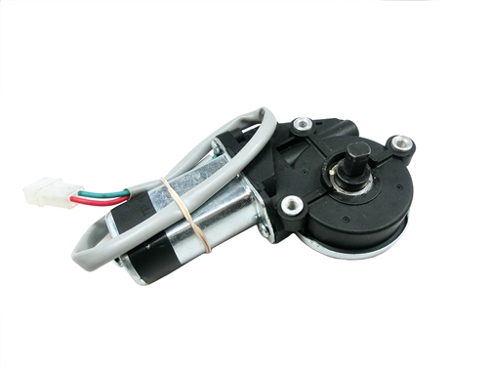
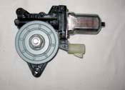
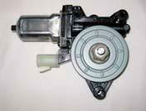
Low Power Dubious Utility
Denso
Window Motor
262100-3030 (Right)
262100-3040 (Left)
AndyMark
Snow Blower Motor
am-2235
Denso
Throttle Motor
AE235100-0160
Motors already attached to gears so reduction ratio is fixed. Difficult to mount. Difficult to wire. Awkward shapes.
Bosch Seat
Recliner Motor
82794153-3

Slide 31
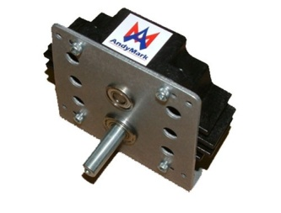
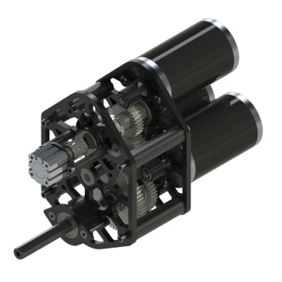
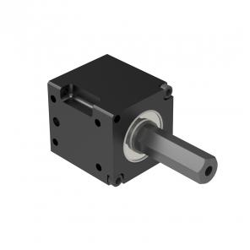
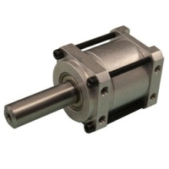
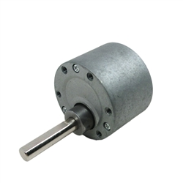
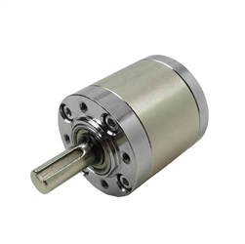
Gearboxes, Gears
CIM
Andymark - www.andymark.com
VexPro - www.vexrobotics.com/vexpro/
Banebots - www.banebots.com
Other High Power
Andymark, VexPro, Banebots
Low Power Highly Useful
AndyMark
Low Power Dubious Utility
Gearboxes built in – not needed
AM Mini
Toughbox
VexPro
Shifting
Gearbox
VexPro
VersaPlanetary
BaneBots
16:1
AM
PG-27
AM-3106
NeveRest 40

Slide 32
Other Means of Reduction
Sprocket / Chain, Pulley / Belt, External Gears
Typically used in single stage in combination with gearbox as manufactured to get the required speed torque
Pulley Belt system requires precise or adjustable wheel positioning
Gear Systems are heavy but least susceptible to slippage

Slide 33
Drive Train Example
A single CIM is attached to a AndyMark Mini-Tough Box with 8.54:1 Reduction, the ½” output shaft is attached to a 1.45” diameter sprocket which is attached to a 2.683” sprocket on a 6” wheel. What is the maximum possible speed of the robot?

Slide 34
Speed Calculations
Maximum CIM Speed is Free Speed 5310 rpm or 88.5 rev/s
Total Reduction
8.54 x 2.863”/1.45” = 16.86
Rotational Speed at Wheel
88.5 rev/s / 16.86 = 5.25 rev /s
Make | Part Number | Max Power (W) | Stall Torque (oz-in) | Free Speed (rpm)
CIM | FR801-001 | 337 | 343 | 5310

Slide 35
Speed Calculations
Speed on 6” Wheel
5.25 rev/s x Circumference = 5.25 rev/s x π x 6” = 99 “/ s = 8.2 ft/s

Slide 36
Lift Calculations
A Banebots 775-18 Motor is attached to a 64:1 Gearbox to 1” radius sprocket which is drives a chain to lift an object. How heavy can the object be? How fast could the maximum weight object be lifted?

Slide 37
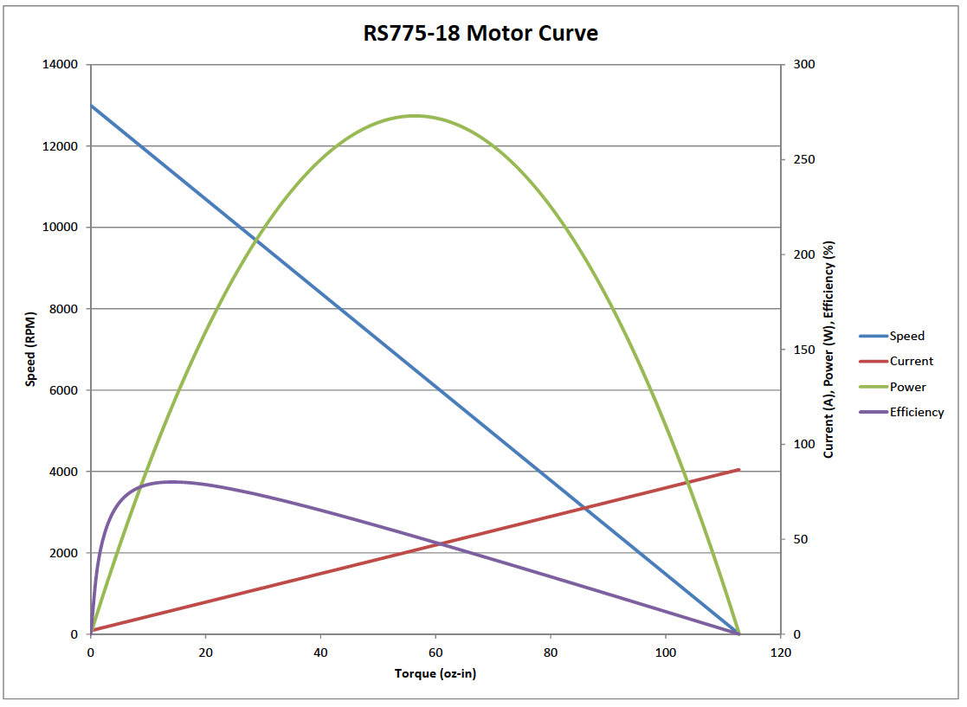
40 Amp Circuit Breaker
49.1 oz-in torque

Slide 38
Force Calculations
Banebots 775-18 has 49.1 oz-in torque with 40 amp circuit breaker
Using 64:1 gearbox torque increases to 49.1 oz-in x 64 = 3142.4 oz-in = 196.4 pound-in
Torque = Force x Distance
Force = Torque / Distance = 196.4 pound-in / 1” = 196.4 pounds max

Slide 39
Velocity Calculations
Motor Speed: 7422 rev/m at 40 amps = 123.7 rev/s
Gearbox shaft speed 123.7 / 64 = 1.93 rev/s
Velocity = 1.93 rev / s x Circumference = 1.93 rev/s x 2 x π x 1” = 12.14 in / s = 1.01 ft/s maximum

Slide 40
Warning!!
Theoretical maximum performance will not be achieved in practice due to various energy losses.
Always include a “performance margin” in your calculations!
Test your system to insure it meets your requirements!

Slide 41
Questions?
Contact Me
Tom Milnes
443-778-4982
thomas.milnes@jhuapl.edu

