Slide 1
Chassis / Drive Train 101
Tom Milnes
Team 2199 Systems Mentor
Principal Mathematician JHU/APL
Notes:
Introduction by Mr. Milnes

Slide 2
Chassis / Drive Train
Chassis / Drive Train are foundational elements of your robot
Without the chassis you have no where to place manipulators / drive system and electrical components
Without drive train the robot doesn’t move
Impossible to score any points
Often it is possible to score points by moving past a line in autonomous

Slide 3
What is a Chassis / Drive Train?
Chassis (Merriam Webster Online)
The supporting frame of a structure (as an automobile, television, or robot)
Drive Train (Mr. Milnes’ Definition)
The assembled parts including motors, gearboxes, gears, chains, belts, wheels that make a vehicle move

Slide 4
Chassis
The Foundation for Everything!

Slide 5
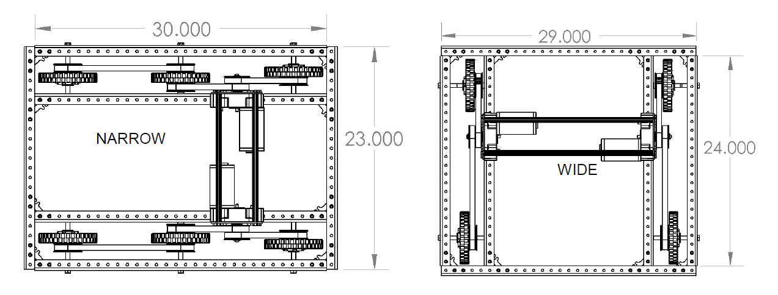
Chassis Shape
Rectangular is the #1 choice of FIRST teams
Simple to construct yet gives plenty of options
Biggest decision is
Narrow Robot – Wheels placed on longest sides
Wide Robot – Wheels placed on shortest sides
Direction of Travel
Direction of Travel
Notes:
Matt

Slide 6
Narrow or Wide?
Depends on the Game Being Played
Want chassis that will allow you to score the greatest number of points / game
Need to figure out your game strategy / manipulators to implement first
Example 2014 Game
Had a 24” diameter ball which you probably wanted to get on your robot so you could transport it and score it in a goal
Had a perimeter limit of 112”

Slide 7
Narrow or Wide?
1”
25”
24”
27”
2 x 27” + 2 x w <= 112” Max Perimeter
w <= 29”
Notes:
Abi

Slide 8
Narrow, Wide, Square?
Everything being equal here are Pros / Cons for Narrow / Wide
Narrow
Harder to block going forward but harder to block other robots
Can segment robot into manipulator section (FWD) and electronics / pneumatics section (AFT)
Less precise turning but quicker
Will pick up fewer objects at a time (objects back to back)
Wide
More precise turning but slower
Manipulator section in center of robot electronics / pneumatics on side
Easier to block other robots and vice versa
Will pick up more objects at a time (objects side to side)
Square
Game element is large and with comparable length and width
Notes:
Abi

Slide 9
Chassis Material
Must be strong enough to hold everything else in place
Must be light enough so you can add drive train and manipulators and stay within weight limit (120 pounds)
Options
Steel – Strong but Too Heavy!
Wood – Light but Too Fragile!
Aluminum – Just Right!!
Exotica – Graphite, Fiberglass, …
Not a good idea for an inexperienced team!
Not a good idea if you haven’t mastered the technology in the offseason (including reliability testing)
Must be able to be repaired!
Notes:
Matt

Slide 10
Chassis – Custom or COTS?
Custom
Machined from CAD drawing
Constructed by hand from square or rectangular tubing
COTS – Commercial Off The Shelf
Robot Parts or Manufacturing Retailers
80-20 - https://8020.net/ “Industrial Erector Set”
AndyMark - http://www.andymark.com
Vexpro - https://www.vexrobotics.com/vexpro

Slide 11
Custom-CAD?
Machined from CAD drawing – ONLY IF
You have several CAD experts
You have a dedicated machine shop that works quickly
You have successfully done this in previous years or in the offseason

Slide 12
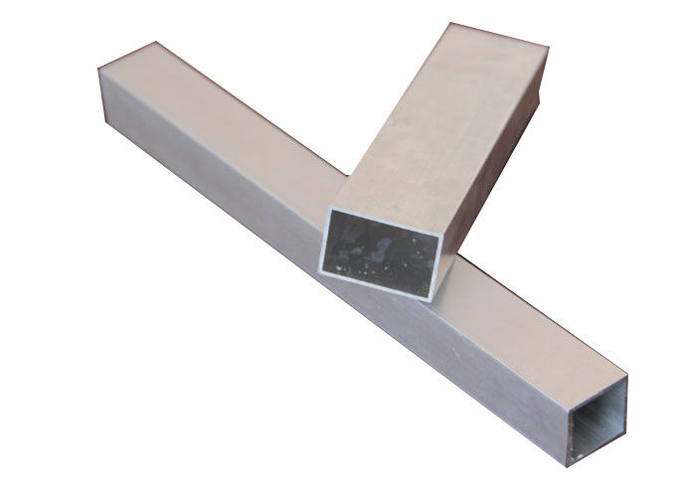
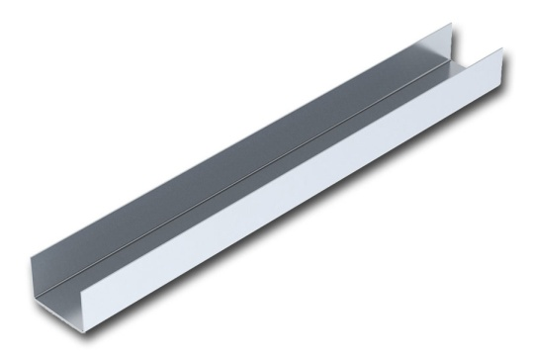
Custom-By Hand?
Constructed from square, rectangular and C channel aluminum tubing which is hand drilled
Quickly available at Home Depot except C-Channel
Not recommended – slow to build and imprecise
Square and Rectangular
C Channel

Slide 13
COTS Chassis Parts
Dedicated Robotics or Engineering supplier
Recommended for rookie, inexperienced, small or under-resourced teams
Lots of good options from
80-20, AndyMark, Vexpro

Slide 14
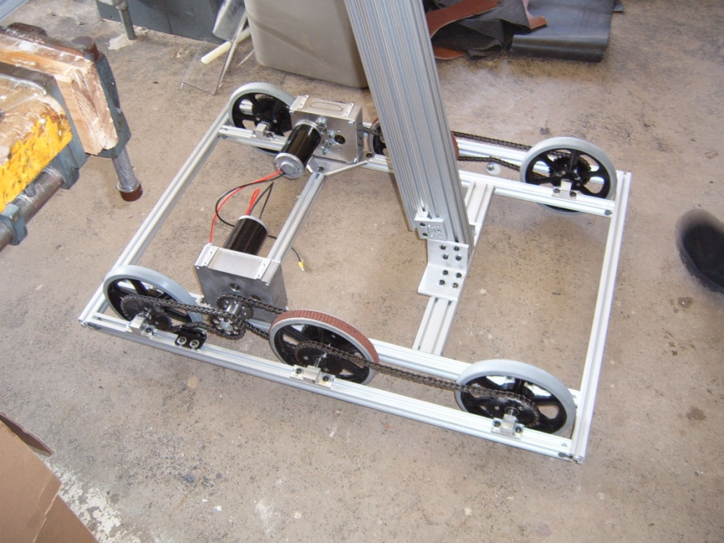
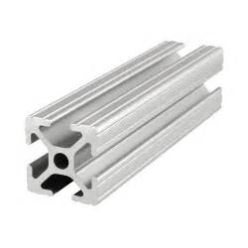
80-20 Chassis Parts
1010 Profile 80-20
1”x1” profile
.51 pounds / ft
Generally utilizes ¼”-20 bolts for fastening but has #10-32 options
80-20 Robot Chassis

Slide 15
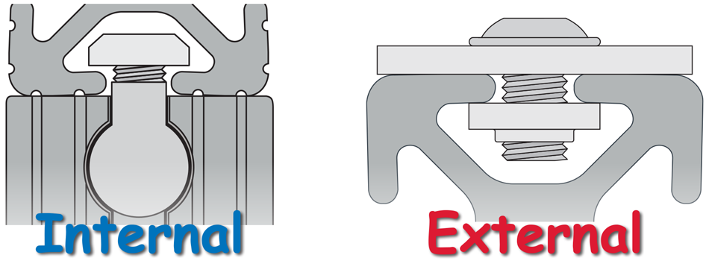
80-20 Fastening
100’s of fastening
Options with 80/20
T-Nut

Slide 16
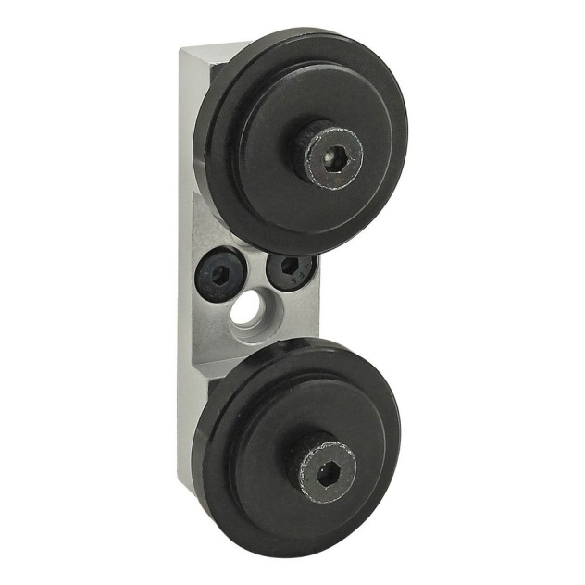
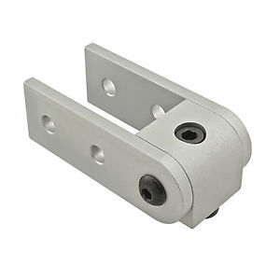
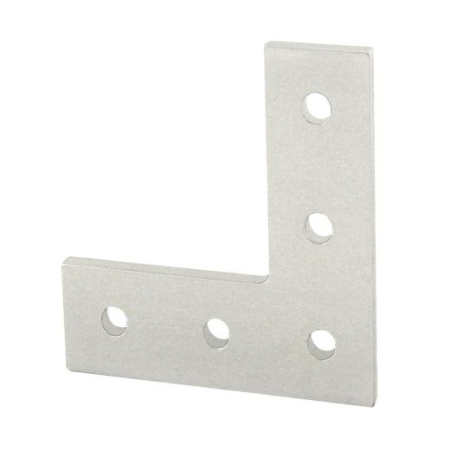
80-20 Parts
80-20 has parts for chassis and manipulator construction including
L-Bracket
Pivoting
Assembly
Roller Set
(Linear Motion)
And 1000’s more!

Slide 17
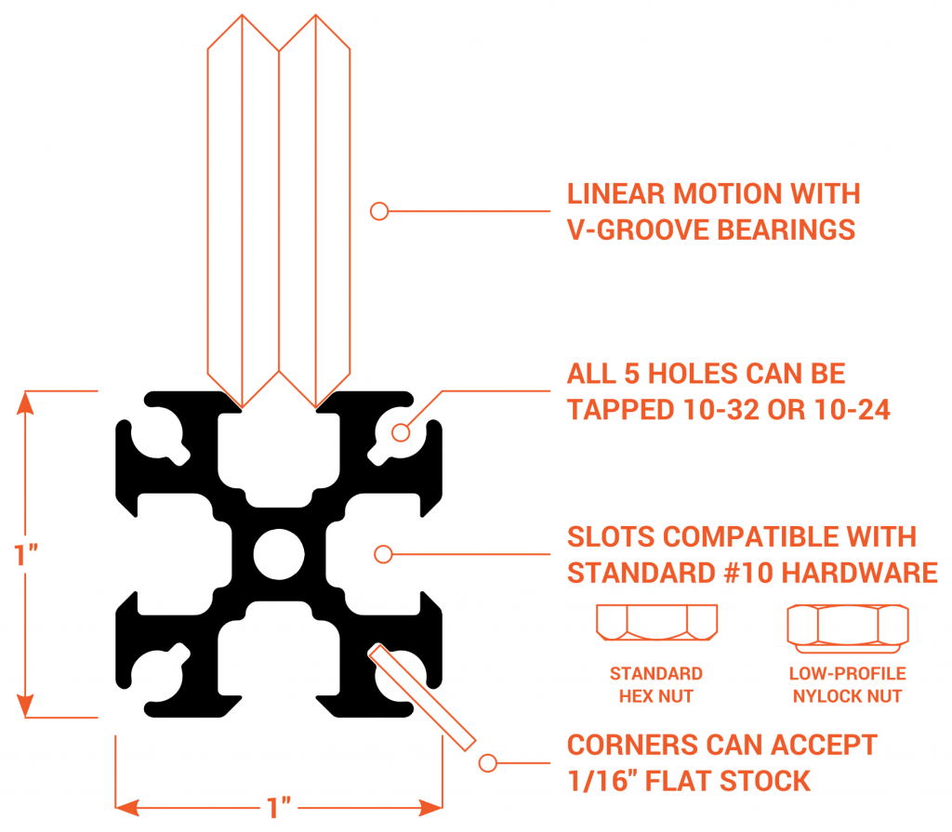
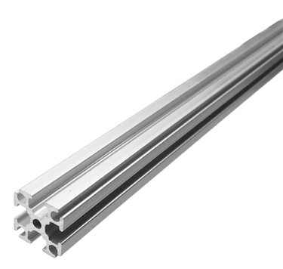
AndyMark Chassis Parts – Rev Robotics* Extrusion
4’ Rev Robotics
1” Extrusion
1”x1” profile
.44 pounds / inch
Uses #10-32 bolts with jam nuts
(#10 = .2”)
*Founded by Greg Needel – FIRST Chesapeake Alumni
http://www.revrobotics.com

Slide 18
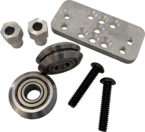
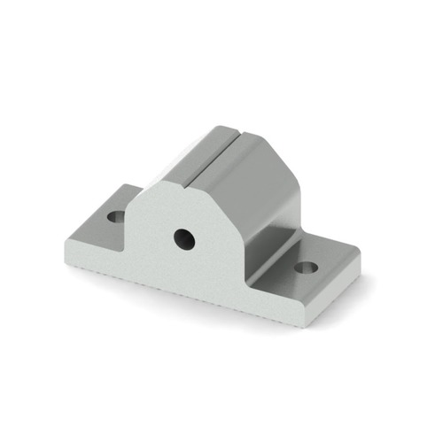
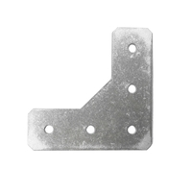
AndyMark Chassis Parts – Rev Robotics* Extrusion
Rev has parts for chassis and manipulator construction including
L-Bracket
Linear Motion
Pillow Block
And 10’s more, but several which are made specifically for FRC

Slide 19
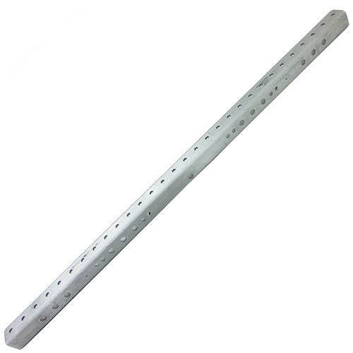
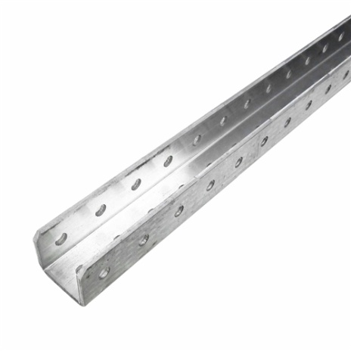
AndyMark Chassis Parts – C-Channel
Also
72” C-Channel
am-3052
30” C-Channel
am-2222
.41 pounds / ft
.43 pounds / ft
¼” holes every 1”, 1/8” thick
1.25” x 1.125” exterior profile
1” x 1” interior profiles – plays well with 80-20 or Rev 1” Extrusion

Slide 20
AndyMark Chassis Parts – Nano Tubes
Combines chassis, gearbox (single speed only), and chain/gears/belts
However interior free versions are available
Comprise the inner two rails in a rectangular drive system
Come in 20” and 31” sizes, with two motor inputs
Linear density of about .9 pounds / foot for chassis components

Slide 21
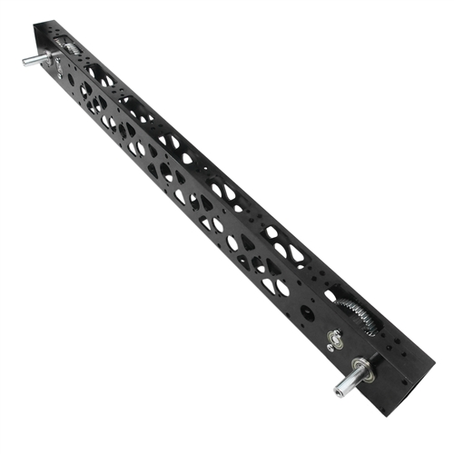
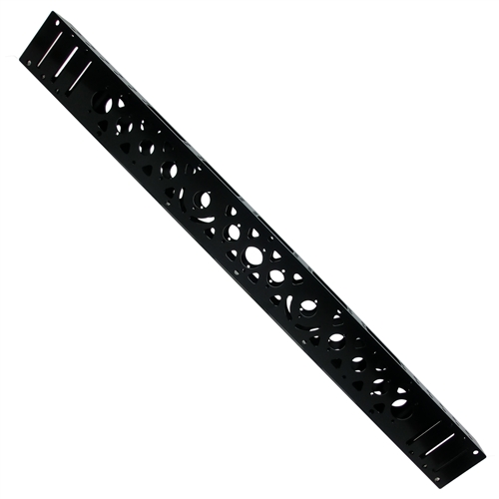
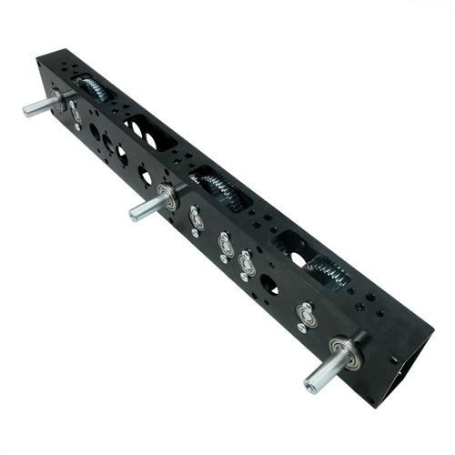
AndyMark Chassis Parts – Nano Tubes
20 Inch Nano Tube
Chained Drive
31 Inch Nano Tube
Gear Drive
31 Inch Nano Tube
Chassis Only

Slide 22
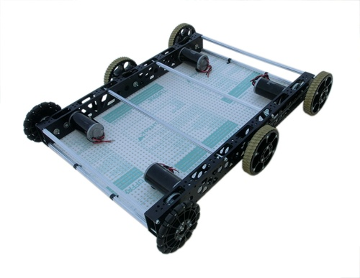
AndyMark Chassis Parts – Nano Tube Robot*
*Outer Chassis Required

Slide 23
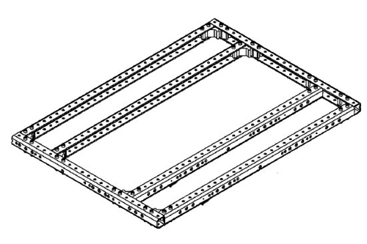
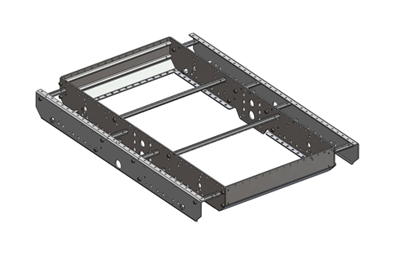
AndyMark Kit Chassis Options
AndyMark C-Base
AndyMark AM14U
9 pounds
11.3 pounds
for max size
Both Kits have holes that cause the center wheels
in 6 wheel tank drives to be lower than forward and rear wheels

Slide 24
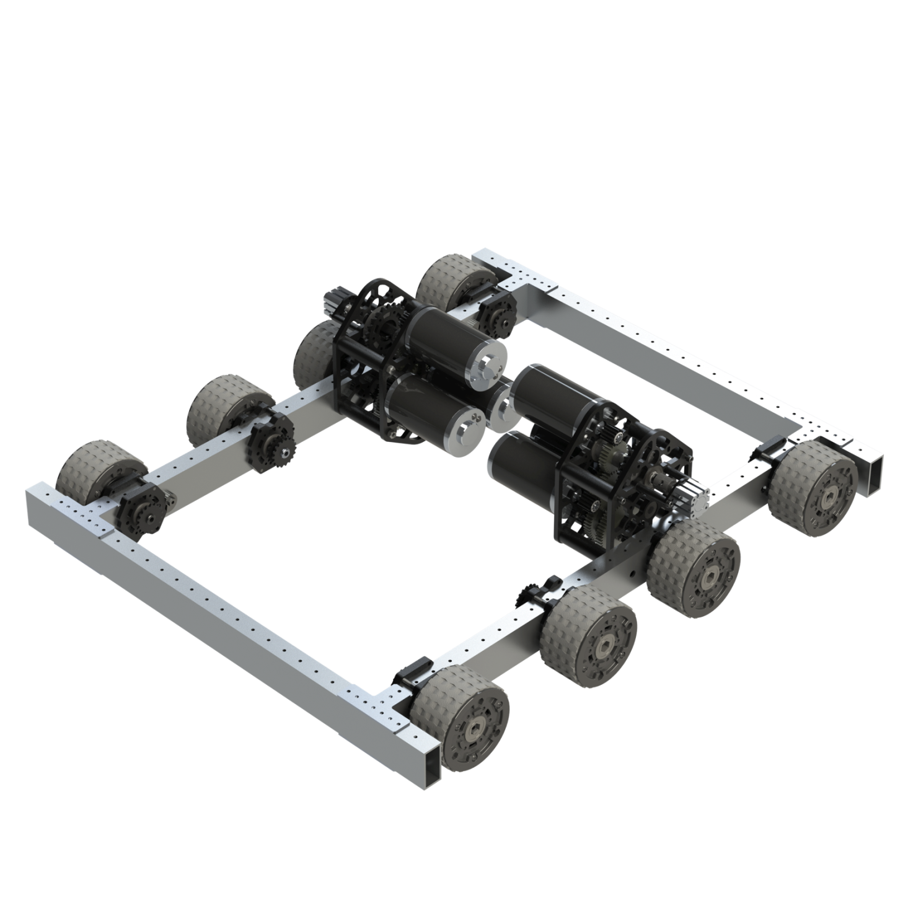
VexPro VersaChassis
No kit available but all the parts!
Plays well with VexPro equipment
Requires lots of drilling
For Wheels and
Gearboxes
2”x1” VersaFrame Stock
.66 pound / ft
.1”thick walls
Uses #8-32 (.177”) bolts and nuts
Lighter duty compared
To 80-20 or AndyMark

Slide 25
Chassis Pan
Placing a rectangular sheet on the bottom of the chassis adds to rigidity of frame and is a good mounting location for battery, electrical components, Robo-Rio, Compressor, Air Tanks, …

Slide 26
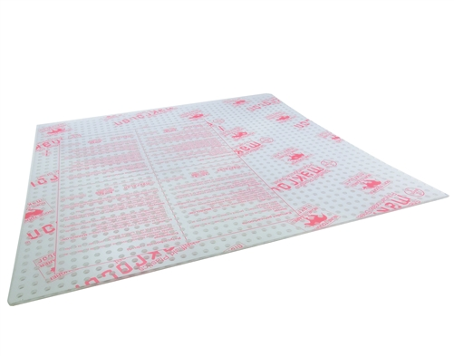
Chassis Pan Options
AndyMark PVC Pegboard
White Pegboard
¼” holes every inch
Approximately $3.5 / sq. ft.
¼” holes every inch
$1 / sq. ft. at Home Depot
Both are electrical insulators

Slide 27
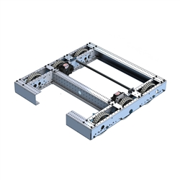
Open Chassis
If the game requires you to pick up game pieces off the floor an open chassis is a good option.
You’ll probably need some way to reinforce the open end of the robot so both sides don’t wiggle
Stuff that would have gone in chassis pan need to be placed elsewhere, ideally light weight stuff
X

Slide 28
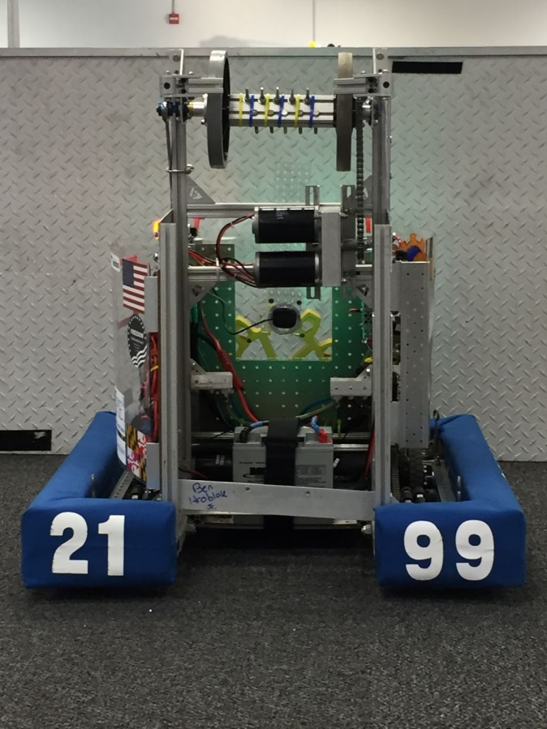
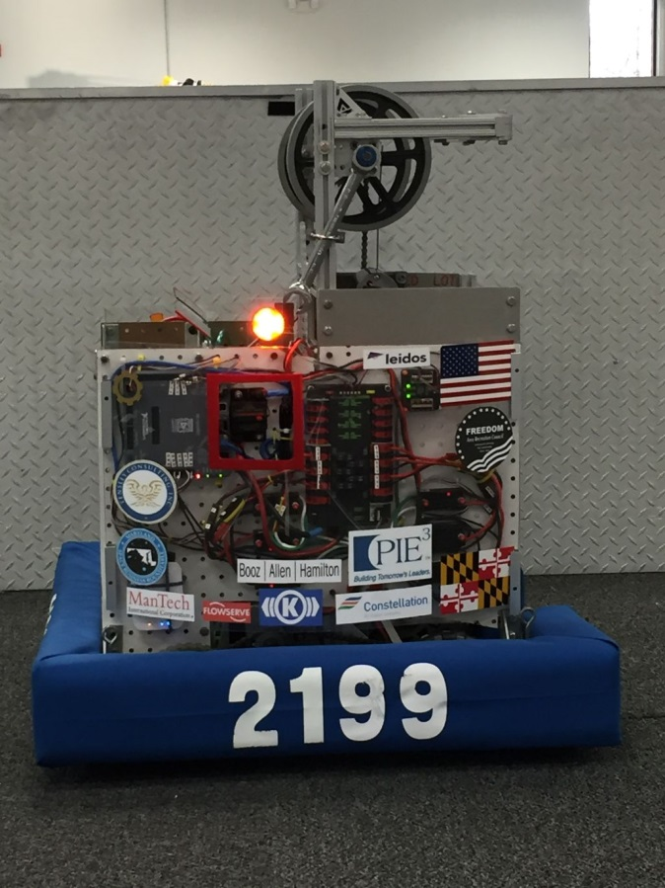
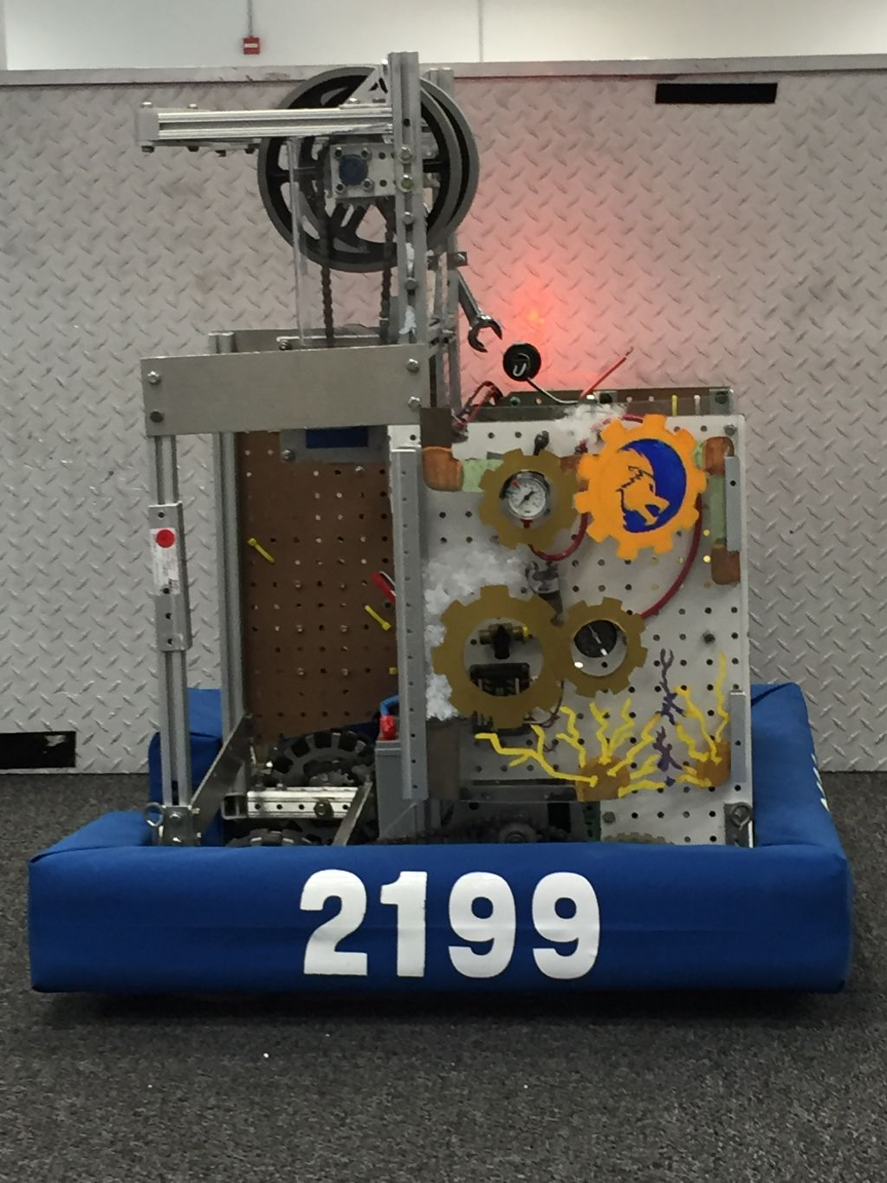
Open Chassis
Stuff that would have gone in chassis pan need to be placed elsewhere, ideally light weight stuff
Vertical mounting planes preferable to horizontal

Slide 29
Center of Mass
Robot naturally translates and rotates about its center of mass
The 3-D balance point
Stability and Mobility increases when CM is low and centered
Put light parts high as needed
Keep heavy parts low
Battery motors pump, etc.
Ms. Mobile
Battery motors pump, etc.
Mr. Tippy

Slide 30
Center of Mass
Ideally for a closed chassis robot battery would be in the center of the robot on the chassis pan
If not possible (many open chassis designs) compensate by moving other heavy objects to counterbalance battery
For instance drive gearboxes and motors
Always keep battery low!!

Slide 31
Chassis Summary
Choose Narrow or Wide Chassis based on your chosen game strategy / chosen manipulators
Construct chassis out of aluminum parts
Choose COTS or Custom (CAD / Machine Shop) based on your team’s experience level
Avoid trying something you haven’t already done in previous years or in the offseason
Place pan at bottom of chassis for mounting stuff if closed chassis
Consider open chassis when game pieces are on floor
Place electronics / pneumatics on vertical planes
Keep center of mass low and centered

Slide 32
Drive Train
Let’s Make That Robot Move!

Slide 33
Drive Train – Components
Motors
Converts electrical power to mechanical power at low torque and high speed
Gearbox
Converts mechanical power to higher torque and lower speed
Chain, Belt, or Gears
Transmits mechanical power to wheels
Wheels, Tracks
Rotate to move the robot

Slide 34
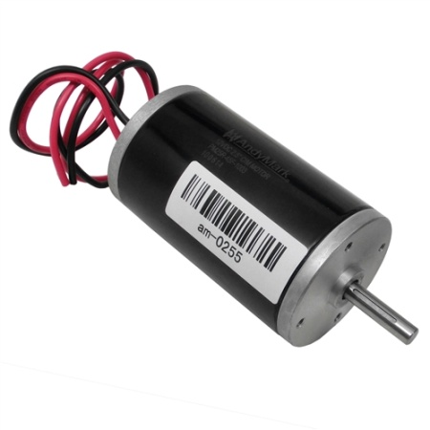
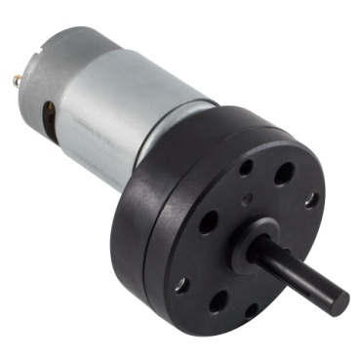
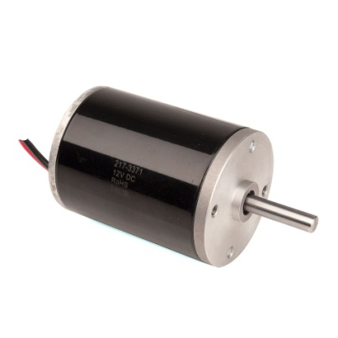
Drive System - Motors
CIM
#1 Choice – Rugged and made for continuous usage
Other alternatives
RS 775 or 550 with CIM-ile adaptor or Mini-CIM
Used when some CIMs are needed for heavy duty manipulators
Used to increase robot traction if not needed for manipulators
CIM Motor
RS 550
CIMile
Mini CIM

Slide 35
Drive System - Gearboxes
COTS
AndyMark and VexPro
Single Speed or Dual Speed (shifting)
2 or 3 motor versions
Custom
Only if you have already built one in the off-season
Can have parts custom machined quickly
Not recommended for small, rookie, or inexperienced teams!!

Slide 36
Single Speed vs. Shifting
Single Speed Gear Boxes are simpler
But you have to choose a single speed / torque range
Fast speed and low torque – offensive robot
Medium speed / medium torque – compromise robot
Low speed / high torque – defensive robot
Shifting is more complicated because of the need for pneumatic or electrical actuators
But can shift from high speed / low torque to low speed / high torque
Can play offense and defense equally well

Slide 37
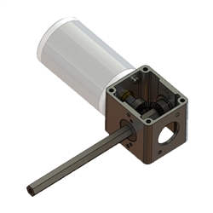
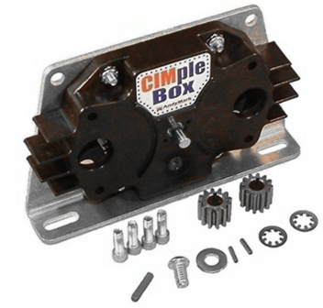
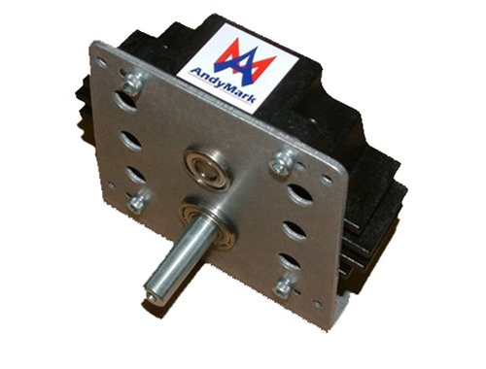
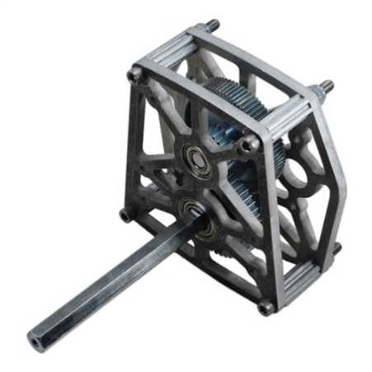
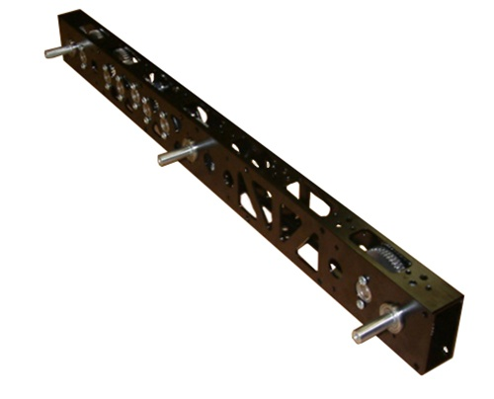
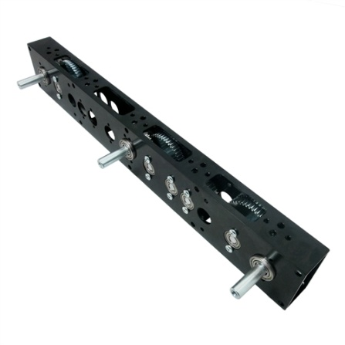
AndyMark Single Speed Gearboxes
LJ Bevel Box
CIMple Box
Toughbox Mini
$110
$59
$89
Nano Tube 31
Nano Tube 20
EVO Slim 2
$286
$281
$129

Slide 38
AndyMark
Lots of Choices
AndyMark gearboxes generally use US Digital Encoders
US Digital encoders can be finicky!!

Slide 39
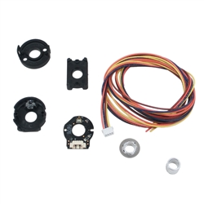
US Digital Encoder
Some people swear by them!
Some people swear about them!
$42

Slide 40
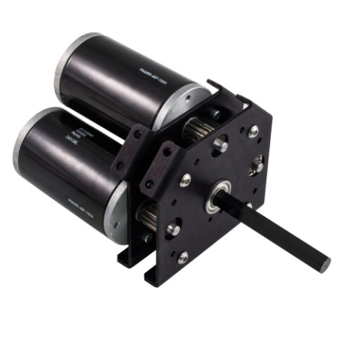
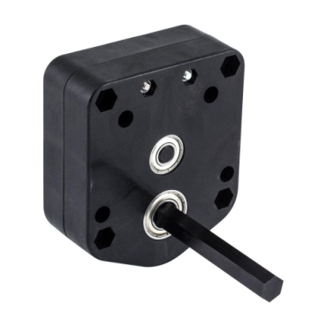
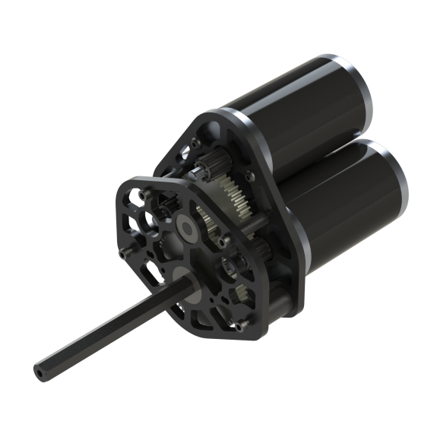
VexPro Single Speed Gearboxes
Single Speed Single Reduction
Single Speed Double Reduction
2 CIM Only
$60
$65
Single Speed West Coast Drive
$90

Slide 41
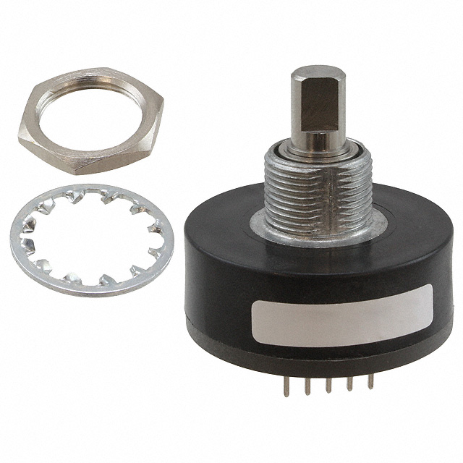
VexPro SS Gearboxes
Not as heavy duty as the Toughbox
Support long shafts!!
But very affordable!!
Use Greyhill 63R Mechanical Encoder
Very reliable and easy to use
$56

Slide 42
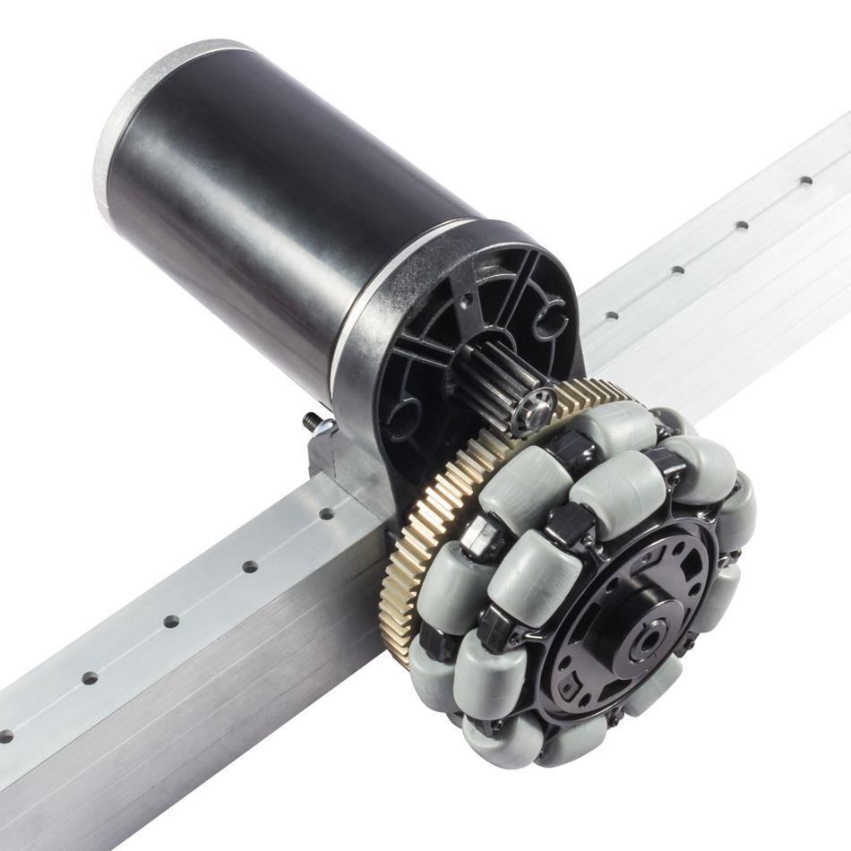
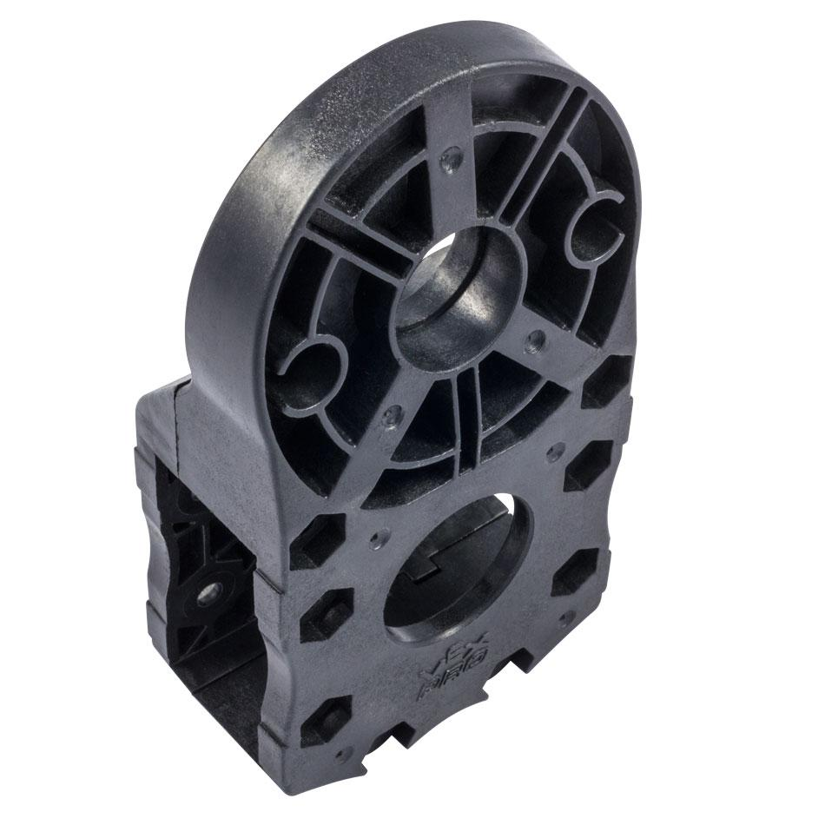
VexPro Single Reduction Clamping Gearbox

Slide 43
VexPro Single Reduction Clamping Gearbox
Have to use 1” x 2” Versaframe tube or equivalent.
If so, may be a good choice in a single speed gearbox since it is very light

Slide 44
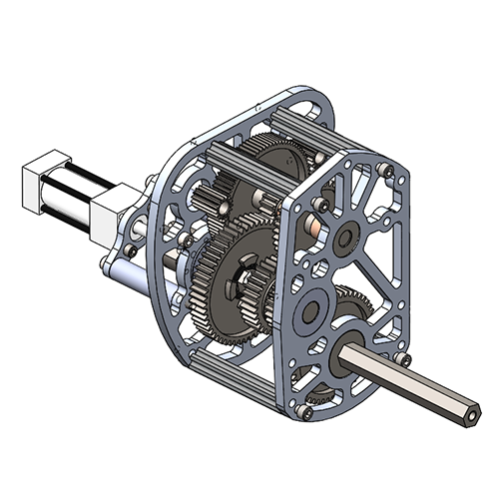
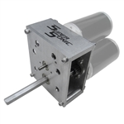
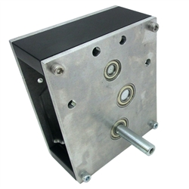
AndyMark Shifting Gearboxes
Extremely Rugged Designs
EVO Shifter
2 or 3 CIM Variants
Machined to AM14U
Bolt Pattern
Multiple Gear Ratios
Sells for $325
Super Sonic Shifter
2 or 3 CIM
Simple Rectangular
Bolt pattern
Fixed High / Low
Ratios
Sells for $319
Sonic Shifter
2 CIM only
Multiple Gear Ratios
Sells for $279

Slide 45
AndyMark Shifting Gearboxes
Very Heavy Duty
Typically don’t need shaft support
Use US Digital Encoders
Light Duty
Servo and Pneumatic Shifting
Servo will not support shifting on the fly

Slide 46
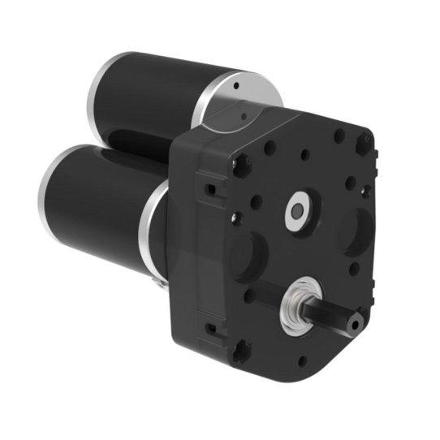
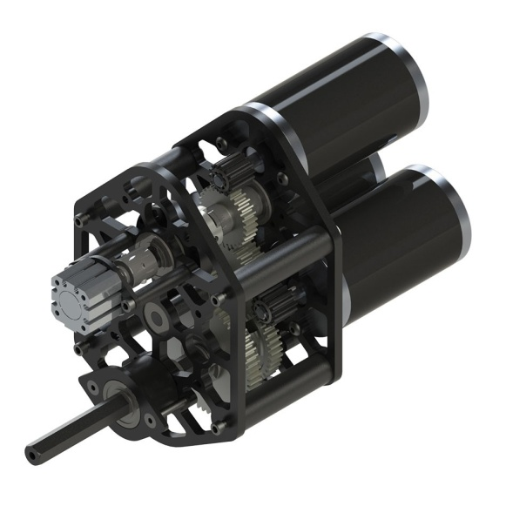
VexPro Shifting Gearboxes
3 CIM Ball Shifter
West Coast Products
Dog Shifter
$110
$240
More Affordable than AndyMark two speed shifters, but lighter duty

Slide 47
VexPro Shifting Gearboxes
Not as heavy duty as AndyMark
Very attractively priced
Will have to support long shafts!
Pneumatic Shifting Only
Guaranteed shift on the fly
Uses Mechanical Greyhill 63R Encoder
Very reliable and easy to use

Slide 48
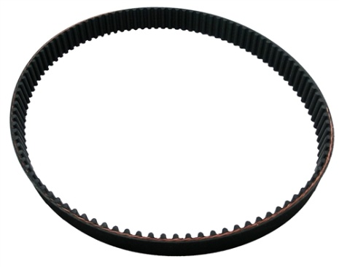
Power Transmission
Belts
Efficient and grease free
Can’t change length
Use either canned design (AM14U) or be very precise in designing (flexible wheel location)
Requires pulleys that match belts used
Chains
Can “break chain” to change length
Difficult to get perfect length even using half links ->
Chain Tensioner
Axle Position Adjuster
FRC Specific
Pillow Blocks

Slide 49
Chain Tensioners
Adjustable Arm
Chain Tensioner
Floating Chain
Tensioner
Ring or Sprocket
Tensioner
Available at McMaster Carr https://www.mcmaster.com
The “Industrial Wal-Mart”

Slide 50
Axle Position Adjusters for FRC
221 Robotics RockBox Chassis
VexPro Drive Bearing Block
Cam Bolt

Slide 51
Pillow Blocks
Low Profile
Mounted
Vibration Damped
Examples from McMaster Carr
Need to use 80-20 or Rev Extrusion to allow adjustment of axle location to tighten chain

Slide 52
Power Transmission
Gears
Very rugged but requires extreme precision if hand made
COTS solutions such as Nano Tube from AndyMark or VexPro Clamp On are attractive alternatives to hand made
Can be heavy if a lot of gears are used

Slide 53
Power Transmission
Direct Drive
Used for centered wheel in West Coast Drive
Used for Omni, Mecanum, and Swerve Drive systems
Most reliable but may require more gearboxes if used for all wheels
Mounting gearbox to frame to achieve direct drive can often be challenging
Consider mounting and axle support methods before buying a gearbox
VexPro Direct
Drive Example

Slide 54
Wheels, Tracks

Slide 55
Solid Rubber Wheels
AndyMark
Colson
Intermediate traction but allows some sideways skid for turning
Smaller rubber wheels are easier to turn (4”)

Slide 56
Traction Wheels
Highest traction but resistance to side skidding can complicate turning
May choose traction wheels as center wheels and something else for front and back
AndyMark
VexPro

Slide 57
Pneumatic Wheels
Intermediate Traction
Excellent for overcoming bumps or obstacles
Resistance to skidding can make turning somewhat difficult – may require extreme center wheel drop
AndyMark

Slide 58
Omni Wheels
Small rubber wheels mounted sideways
Intermediate traction forward but moves sideways freely so turning not a problem
AndyMark
VexPro

Slide 59
Mecanum Wheels
Skateboard wheels rotated 45° to main wheel frame
Requires an entire set to implement “Mecanum Drive” with rollers making a “X”
AndyMark
VexPro

Slide 60
Mecanum Drive

Slide 61
Mecanum Drive
If front wheels move in opposite direction to back wheels vehicle moves sideways
Called strafing
Gives two directions of freedom in translation
Robot is extremely nimble!
Mecanum wheels are expensive!
Traction is compromised due to rolling elements and 45° angle
For the right game can be an excellent choice

Slide 62
Tank Treads
AndyMark Rhino Tank Drive

Slide 63
Tank Treads
Not a nimble turner but fast going straight
Good choice for obstacle defeat
Probably best to get a Tread System
Tread and Roller Wheels
Expensive!!
AndyMark product $369 per side

Slide 64
Drive Type
Lamborghini

Slide 65
Arcade Drive
All cars use Arcade Drive
Front Wheels Turn, Rear Wheels fixed

Slide 66
Arcade Drive
Big Problem
Makes really large turns!!
FRC Fields can require tight turns!
2017 Field

Slide 67
Tank Drive
M1A1 Abrams Tank

Slide 68
Tank Drive
For FIRST Robotics “Tank Drive” means wheels on left and right sides are driven independently – normally with two joysticks
Only a single gearbox per side
Can turn in place, go forward and backward
Good combination of simplicity and performance
The most popular drive system in FIRST!!

Slide 69
Tank Drive
Motors
Gearboxes
Wheels
Chain or Belt

Slide 70
Tank Drive
How does a wheeled tank
drive robot turn in place
with the narrow wheels
pointed in a single direction?

Slide 71
Some Tank Drive Turning Solutions
#1 Lower the center wheels slightly
Use omni wheels at the end of the robot
Causes loss of traction
Can be turned easily by other
robots!
C-Channel
Axle Locations
Omni

Slide 72
Not So Good Tank Drive Turning Solutions
Using caster wheels (which turn in any direction) is a tempting solution.
PROBLEM
Undriven caster wheel reduces weight on driving wheels
Reduced traction on Driving Wheels
SOLUTION
All wheels need to be powered!!
Caster Wheel

Slide 73
Holonomic (2-D Translation) Drive Systems

Slide 74
Mecanum Drive
Complete Mecanum Chassis / Drive Train
From AndyMark

Slide 75
4-Omni Drive
Uses 4 Omni Wheels configured in a “+” or “x” configuration

Slide 76
4-Omni Drive
Highly maneuverable but has less traction than even the mecanum drive
Only ½ of the motors are pushing in any direction
Not recommended

Slide 77
H-Omni Drive

Slide 78
H-Omni Drive
Basically a Tank Drive with a Slider Wheel
More traction than 4-Omni Drive but lots less than tank drive
Requires only 3 gearboxes
Not a bad choice for 2015 game Recycle Rush
Since opposing alliances were on opposite of field with no defense played

Slide 79
Exotica

Slide 80
Swerve Drive
4 wheels with separate gearboxes that can rotate in any direction

Slide 81
Swerve Drive
Point the wheels in the direction you want to translate

Slide 82
Swerve Drive
Rotate wheels in a circular pattern to rotate robot

Slide 83
Swerve Drive
$325
AndyMark Swerve
Drive System

Slide 84
Swerve Drive
Highly Capable
2-D translation and rotation without loss in traction
Is a complete transmission system
Extremely expensive
A single swerve drive assembly (1 wheel apiece) costs $325 or more
Requires 1 CIM drive motor and 1 other motor to rotate wheel
Very complicated to program
Not recommended for rookie or inexperienced teams
Should be mastered in off-season

Slide 85
Transforming Drives
Octanum Drive
Either
4 traction wheels for pushing, straight running
4 mecanum wheels for maneuverability
Butterfly Drive
Either
4 traction wheels for pushing
4 omni wheels for maneuverability

Slide 86
Pneumatic Drive System Change
Chain / Belt
Pneumatic
Piston
Traction
Wheel
Sprocket /
Pulley
Mecanum
Wheel
Drive Axle

Slide 87
Drive Systems
Lots of choices!
Choose drive system and drive system components based on
Required robot performance according to game strategy
Experience with components and systems
Financial and Weight budgets

