Slide 1
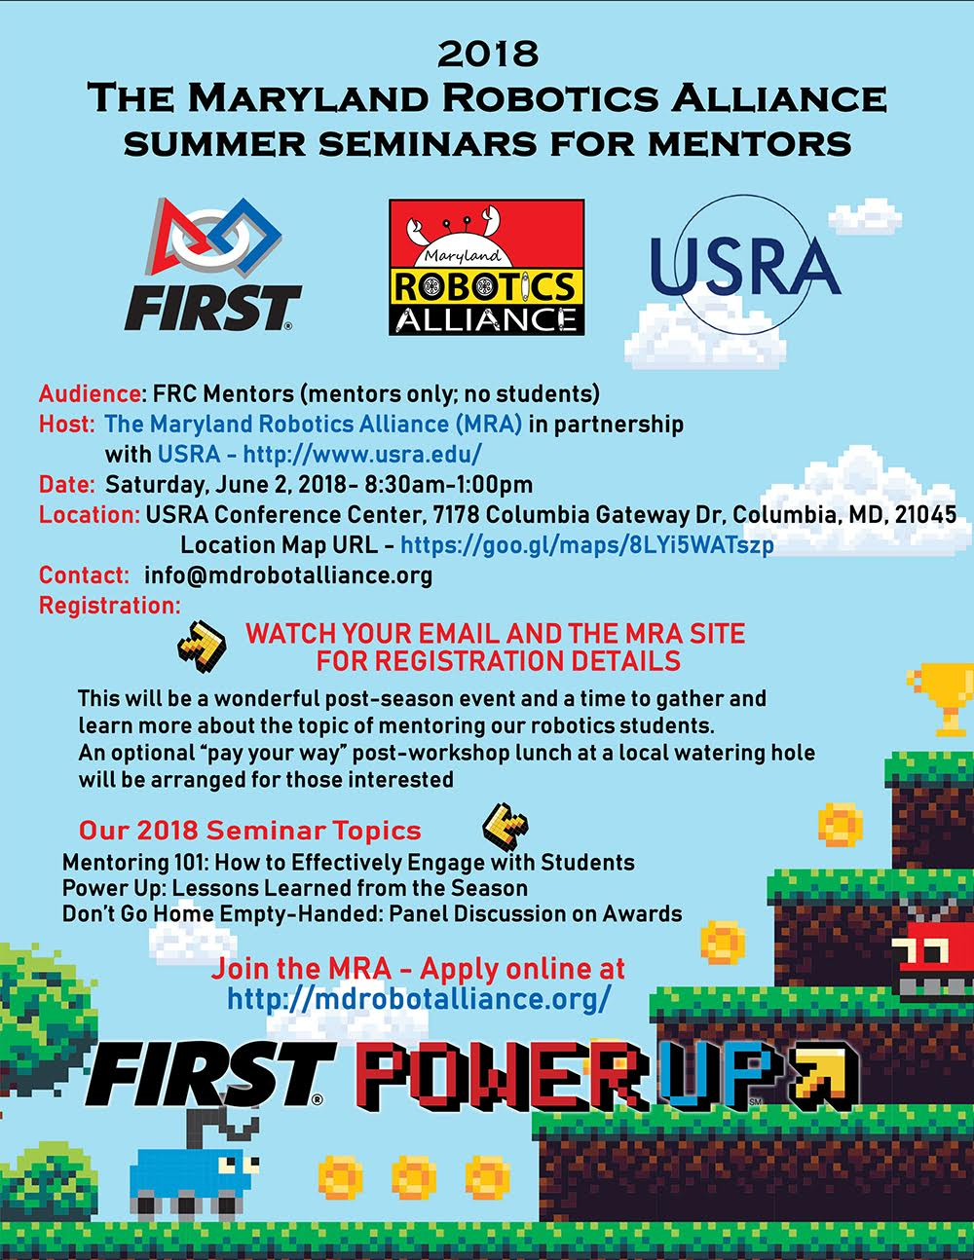

Slide 2
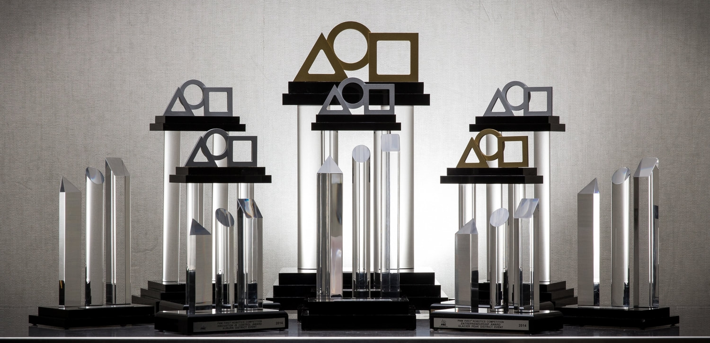
FIRST Robotics Competition
Awards Overview
Grant Dekker
6/2/2018
The Maryland Robotics Alliance Summer 2018 Seminars for Mentors
Notes:
Credits and thanks to Kristine Atiyeh – FRC 125 (see referenced presentation at end) and
Jenny Beatty from the Chesapeake District.
Grant Dekker – Judge for 10 years, JA for a few, and Stage Advisor at Worlds this year.

Slide 3
For today:
Why awards
What awards
Who/where are the judges
How to “Don’t Go Home Empty-Handed”

Slide 4
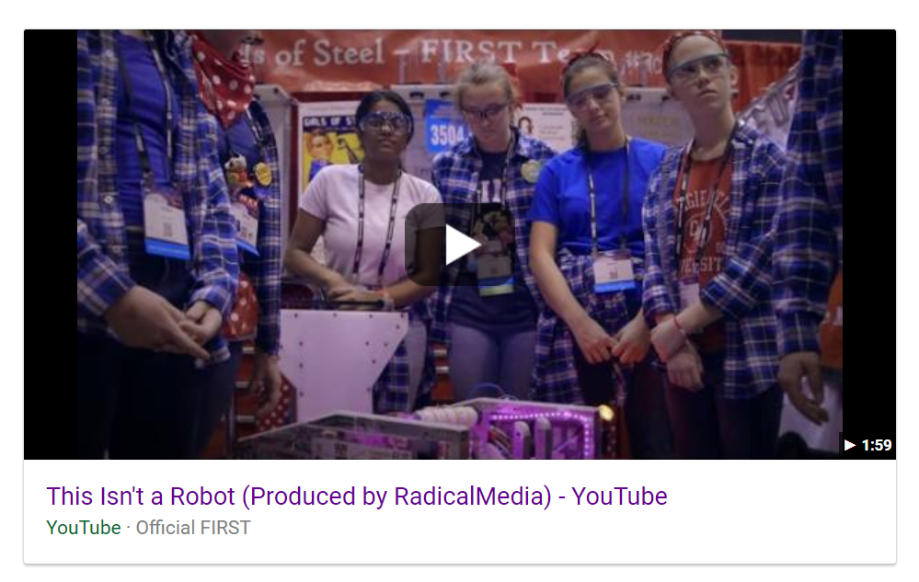
Why awards
This isn’t a Robot
“… it is a machine to build the people who will change the world.”
Notes:
https://www.youtube.com/watch?v=mtE6Va6oOhU
When it comes to understanding the mission, vision, goals, and core values of FIRST this one video brings out all of them….

Slide 5
Why Awards?
Reinforce the goals of FIRST (aligned)
FIRST – Inspiration and Recognition
Inspires confidence and motivates
Success builds reputation
Nice additions to students’ resumes
Can advance you forward to District Championships on to Worlds
It builds networks
It provides opportunities for engaging with community, community leaders
Provides organizational structure and focus
Notes:
… and you see that the awards reinforce and are aligned with the goals of FIRST.
Awards inspire and recognize – inspiring confidence and motivation. With success a team’s reputation grows at school, among teams, in the community, sometimes in the political arena, all the way to Hollywood producers. Sure, awards look good in the trophy case and on students’ resumes. They also provide value in helping you achieve the next level of competition, like the District Championships or Worlds.
There are also the side effects of helping build networks with fellow teams, sponsors, mentors, and the community while you focus on working toward awards – these are life skills opportunities. Finally, awards provide for a team to have some organizational structure and focus. Working toward awards provides a natural framework for organizing a highly effective team. Finally, awards allow for a wide variety of skills (and diversity of skills and backgrounds) to help make a well-rounded team.

Slide 6
What awards?
Notes:
There are non-judged and judged awards. We are focused on judged awards here. Non-judged awards include winning and runner-up alliances, rookies’ highest seed, etc.

Slide 7
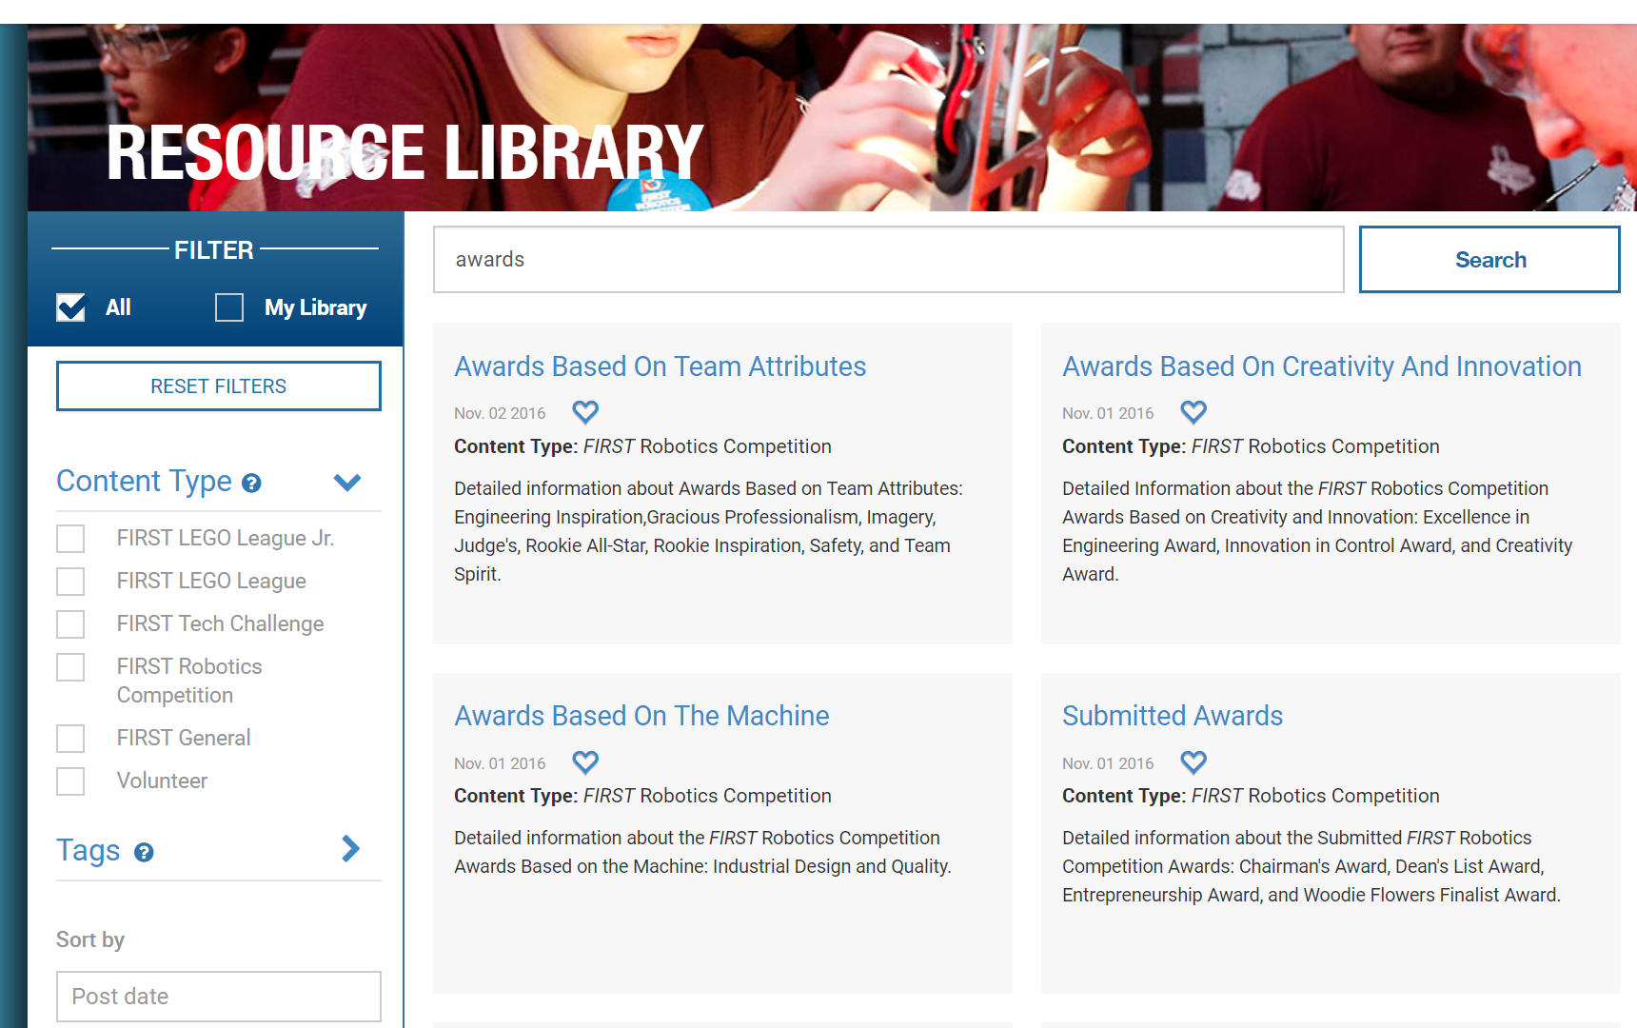
https://www.firstinspires.org/resource-library
https://www.firstinspires.org/resource-library/frc
Notes:
https://www.firstinspires.org/resource-library/frc
The FIRST resource library offers excellent references for understanding all the FRC awards along with all the criteria looked at for each one. The four categories of awards are listed from a search in the resource library. A lot of other information is there.

Slide 8
Awards Based on Team Attributes
Team Spirit Award Sponsored by FCA Foundation
Imagery Award in honor of Jack Kamen
Gracious Professionalism Award Sponsored by Johnson & Johnson
Rookie All-Star Award
Rookie Inspiration Award Sponsored by National Instruments
Engineering Inspiration Award
Safety Award Sponsored by UL
Notes:
Links to the descriptions in the FIRST Resource Library in the slide above.

Slide 9
Awards Based on Team Attributes (1 of 2)
Team Spirit Award sponsored by FCA Foundation
Celebrates extraordinary enthusiasm and spirit through exceptional partnership and teamwork furthering the objectives of FIRST.
Imagery Award in honor of Jack Kamen
This award celebrates attractiveness in engineering and outstanding visual aesthetic integration of machine and team appearance.
Gracious Professionalism® Award Sponsored by Johnson & Johnson
Celebrates outstanding demonstration of FIRST Core Values such as continuous Gracious Professionalism® working together both on and off the playing field.
Notes:
From just looking at the subheading under the titles of the awards from the documentation, one can see some key phrases, adjectives, adverbs, etc. that are key to how those awards are judged.

Slide 10
Awards Based on Team Attributes (2 of 2)
Rookie All-Star Award
Celebrates the rookie team exemplifying a young but strong partnership effort, as well as implementing the mission of FIRST to inspire students to learn more about science and technology.
Rookie Inspiration Award Sponsored by National Instruments
Celebrates a rookie team’s outstanding success in advancing respect and appreciation for engineering and engineers, both within their school, as well as in their community.
Engineering Inspiration Award
Celebrates outstanding success in advancing respect and appreciation for engineering within a team’s school or organization and community.
Safety Award Sponsored by Underwriters Laboratories
Celebrates the team that progresses beyond safety fundamentals by using innovative ways to eliminate or protect against hazards.

Slide 11
Awards Based on the Machine
Industrial Design Award
Quality Award
Notes:
Links to the descriptions in the FIRST Resource Library in the slide above.

Slide 12
Awards Based on Machine
Industrial Design Award Sponsored by General Motors
Celebrates form and function in an efficiently designed machine that effectively addresses the game challenge.
Quality Award Sponsored by Motorola Solutions Foundation
Celebrates machine robustness in concept and fabrication.

Slide 13
Awards Based on Creativity and Innovation
Autonomous Award Sponsored by Ford (Only Championships this past year…but….)
Excellence in Engineering Award Sponsored By Delphi
Innovation in Control Award Sponsored By Rockwell Automation
Creativity Award Sponsored By Xerox
Notes:
Links to the descriptions in the FIRST Resource Library in the slide above.

Slide 14
Awards Based on Creativity and Innovation
Autonomous Award Sponsored by Ford (FIRST Championship Only)
Based on the robot’s ability to sense its surroundings, position itself within the field, and plan and execute tasks during autonomous period.
Excellence in Engineering Award sponsored by Delphi
Celebrates an elegant and advantageous machine feature.
Innovation in Control Award Sponsored by Rockwell Automation
Celebrates an innovative control system or application of control components – electrical, mechanical, or software – to provide unique machine functions.
Creativity Award Sponsored by Xerox
Celebrates creativity in design, use of component, or strategy of play.

Slide 15
Submitted Awards
Woodie Flowers Finalist Award
FIRST Dean’s List Award
Entrepreneurship Award sponsored by Kleiner Perkins Caufield & Byers
Chairman’s Award
Notes:
Links to the descriptions in the FIRST Resource Library in the slide above.

Slide 16
Submitted Awards (1 of 2)
Woodie Flowers Finalist Award
Presented to an outstanding Mentor in the robotics competition who best leads, inspires, teaches, and empowers their team using excellent communication skills.
FIRST Dean’s List Award
Celebrates outstanding student leaders whose passion for and effectiveness at attaining FIRST ideals is exemplary.
Entrepreneurship Award sponsored by Kleiner Perkins Caufield & Byers
Celebrates the entrepreneurial spirit by recognizing a team that has developed the framework for a comprehensive business plan to scope, manage, and achieve team objectives.

Slide 17
Submitted Awards (2 of 2)
Chairman’s Award
The most prestigious award at FIRST, it honors the team that best represents a model for other teams to emulate and best embodies the purpose and goals of FIRST.
Well-rounded in most/all facets of the program
Cohesive
Outreach – community and beyond
Gracious Professionals
Volunteering and mentoring
Ambassadors
Sustained excellence
Notes:
The bulleted list above are characteristics of a well-rounded competitive Chairman’s team.

Slide 18
And the Judges’ Award
Judges’ Award
During the course of the competition, the judging panel may decide a team’s unique efforts, performance, or dynamics merit recognition.

Slide 19
Is there a hierarchy to the awards?
Common question
Besides Chairman’s, Engineering Inspiration, and Rookie All-Star → NO
District Points Model represents this:
10 points for Chairman’s Award
8 points each for Engineering Inspiration and Rookie All Star Awards
5 points each for all other judged Team awards
Notes:
https://firstfrc.blob.core.windows.net/frc2018/Manual/2018FRCGameSeasonManual.pdf
10.12.3.4 Awards This attribute measures Team performance with respect to Team awards judged at the event. The points earned for Team awards in this system are not intended to capture the full value of the award to the Team winning the award, or to represent the full value of the award to FIRST. In many ways, the Team’s experience in being selected for awards, especially the Chairman’s Award, the Engineering Inspiration Award, and the Rookie All Star Award, is beyond measure, and could not be fully captured in its entirety by any points-based system. Points are being assigned to awards in this system only to help Teams recognize that FIRST® continues to be “More than Robots®,” with the emphasis on our cultural awards, and to assist in elevating award-winning Teams above non-award winning Teams in the ranking system. Teams only get points for Team awards judged at the event. If an award is not judged, e.g. Rookie Highest Seed, is not for a Team, e.g. the Dean’s List Award, or is not judged at the event, e.g. Safety Animation Award, sponsored by UL, no points are earned.

Slide 20
Who are the Judges?
Volunteers
Many are engineers or STEM-based professionals but typically a variety of backgrounds
Some are alumni or past mentors
Some have judged for years; some are rookies

Slide 21
Judges do what?
They interview
They watch and observe
They listen
They deliberate
They investigate
They prep in advance
They care
They like questions

Slide 22
Judges do what?
They interview
They watch and observe
They listen
They deliberate
They investigate
They prep in advance
They care
They like questions
And hopefully inspire!
Notes:
Judges not only hopefully inspire, but from personal experience I can say judges are always inspired by the students and teams.

Slide 23
Thoughts on becoming more competitive
Have a strategy for awards
Use the FIRST Community
Make sure everyone on the team knows the Team’s story
First day interviews are important
Know the “pitch”
Highlight uniqueness, make compelling points, make the story stick in the mind of the judges
Focus on pre- and postseason
Notes:
Awards are based on FIRST mission/vision – and provide an actionable approach to organizing a team – which time-after-time seems to make teams more competitive overall. Having a strategy for awards – focus on what you do best. Leverage the FIRST community – award-winning teams naturally love sharing their stories and methods (in a very graciously professional way). First day interviews are critical, so know your pitch – make sure you explain unique, compelling points to the judges. You want them going back to the judges’ room remembering you.
Another place high-performing teams exceed expectations is with a focus working on lessons learned in the postseason and work through the summer and preseason on outreach, volunteering, mentoring, planning, and practicing. It is more than just a build-season exercise….

Slide 24
Being more competitive - drilling down
Whether MCI or Team Attribute-based – show the impact
Document and describe preseason prep and postseason
Describe game prep, techniques, and processes
Show successes, overcoming failures, tackling challenges
Your journey to this season
Plans after this season
Experiences with other teams
Leave-behinds
Talk about your role; talk about your mentor
Judges are there to hear your stories – tell them
Notes:
At the competition, focus on the your pitch – and explain the impact, whether it was a control system to your robot’s success to the methods you use to spread appreciation and excitement for science and technology – and everything between. Document your story – show how the dots connect. Show successes – and also how you overcame failures in getting there. Tell your journey. Leave simple leave behinds that help trigger the judges that interviewed you the unique attributes of your team, robot, etc. Judges will definitely use it as a reminder of why you are deserving and share the details with other judges in the judges’ room. Talk about your personal story and role - talk about your mentors, too. Don’t be afraid to make it a dialog with your judges.

Slide 25
Why does it seem some teams win more than others?
Common question
Document their efforts and ensure continuity (and sustainability)
A focus on continuous improvement
More than build season-only
Mission of FIRST is instilled in them
Gracious Professionalism radiates from their pores
They plan, they execute, they communicate
They know their Team’s story and tell it with enthusiasm
Notes:
We all know them – some teams just seem to be ultra competitive for awards year after year. There seem to be some common characteristics they all share. Here are some of them. They document their efforts and have plans for sustaining their efforts over time. They do not rest on their laurels but continue to raise the bar. They know a winning team focuses on all aspects of FIRST outside of the build season, too. They feel the mission/vision/core values of FIRST. They plan, execute, and communicate (internally, to others, in interviews, and as feedback to continually improve). You feel their energy.

Slide 26
Good references
FIRST’s Team Attributes Descriptions | https://www.firstinspires.org/resource-library/frc/awards-based-on-team-attributes
FIRST’s Machine Descriptions | https://www.firstinspires.org/resource-library/frc/awards-based-on-machine
FIRST’s Team Creativity and Innovation Descriptions | https://www.firstinspires.org/resource-library/frc/awards-based-on-creativity-innovation
FIRST’s Submitted Awards descriptions | https://www.firstinspires.org/resource-library/frc/submitted-awards
FIRST’s Resource Library | https://www.firstinspires.org/resource-library
FIRST’s General FRC Awards Page | https://www.firstinspires.org/robotics/frc/awards
Kristine Atiyeh’s PowerPoint | https://docs.google.com/presentation/d/1OJvExkFbnoZd-SX30fqzx9y98eJhdSh3heIJXwwIxqI/
FIRST’s 2018 Complete Awards Chart | https://www.firstinspires.org/sites/default/files/uploads/resource_library/frc/game-and-season-info/awards/2018/2018-complete-awards-chart.pdf
Notes:
The links above were used in putting these slides together.

