Slide 1
Team Organization

Slide 2
Agenda
Introduction
Team Organization and Structure
Season breakdown

Slide 3
Who We Are
Ms. Jenna Mondoro
12th grade student, South River High School
Chief Executive Officer of The Power Hawks Robotics Team
Ms. Reyna Vrbensky
10th grade student, South River High School
Chief Operating Officer or The Power Hawks Robotics Team
Ms. Emily Kruzon
12th grade student, South River High School
Build Systems Lead of The Power Hawks Robotics Team
Ms. Helen Dover
12th grade student, South River High School
Director of Education of The Power Hawks Robotics Team
Mr. Zachary Cohen
Engineering and Technology Teacher, South River High School
Head Mentor Trainer and Teacher Liaison of The Power Hawks Robotics Team

Slide 4
Importance of Team Organization
Running an FRC team is much like running a business
Too much work for just one person
Team organization allows work to be delegated to multiple levels of leadership
Student and Mentor Partnership
Students and mentors should be able to work together to accomplish tasks
Work should not fall on a singular person’s shoulders

Slide 5
Basic Organizational Questions
What type of team?
Who will make up the team?
How will the team be funded?
Where will the team operate?
When and how often will the team meet?
How big is the team?
What type of team are you going to have?

Slide 6
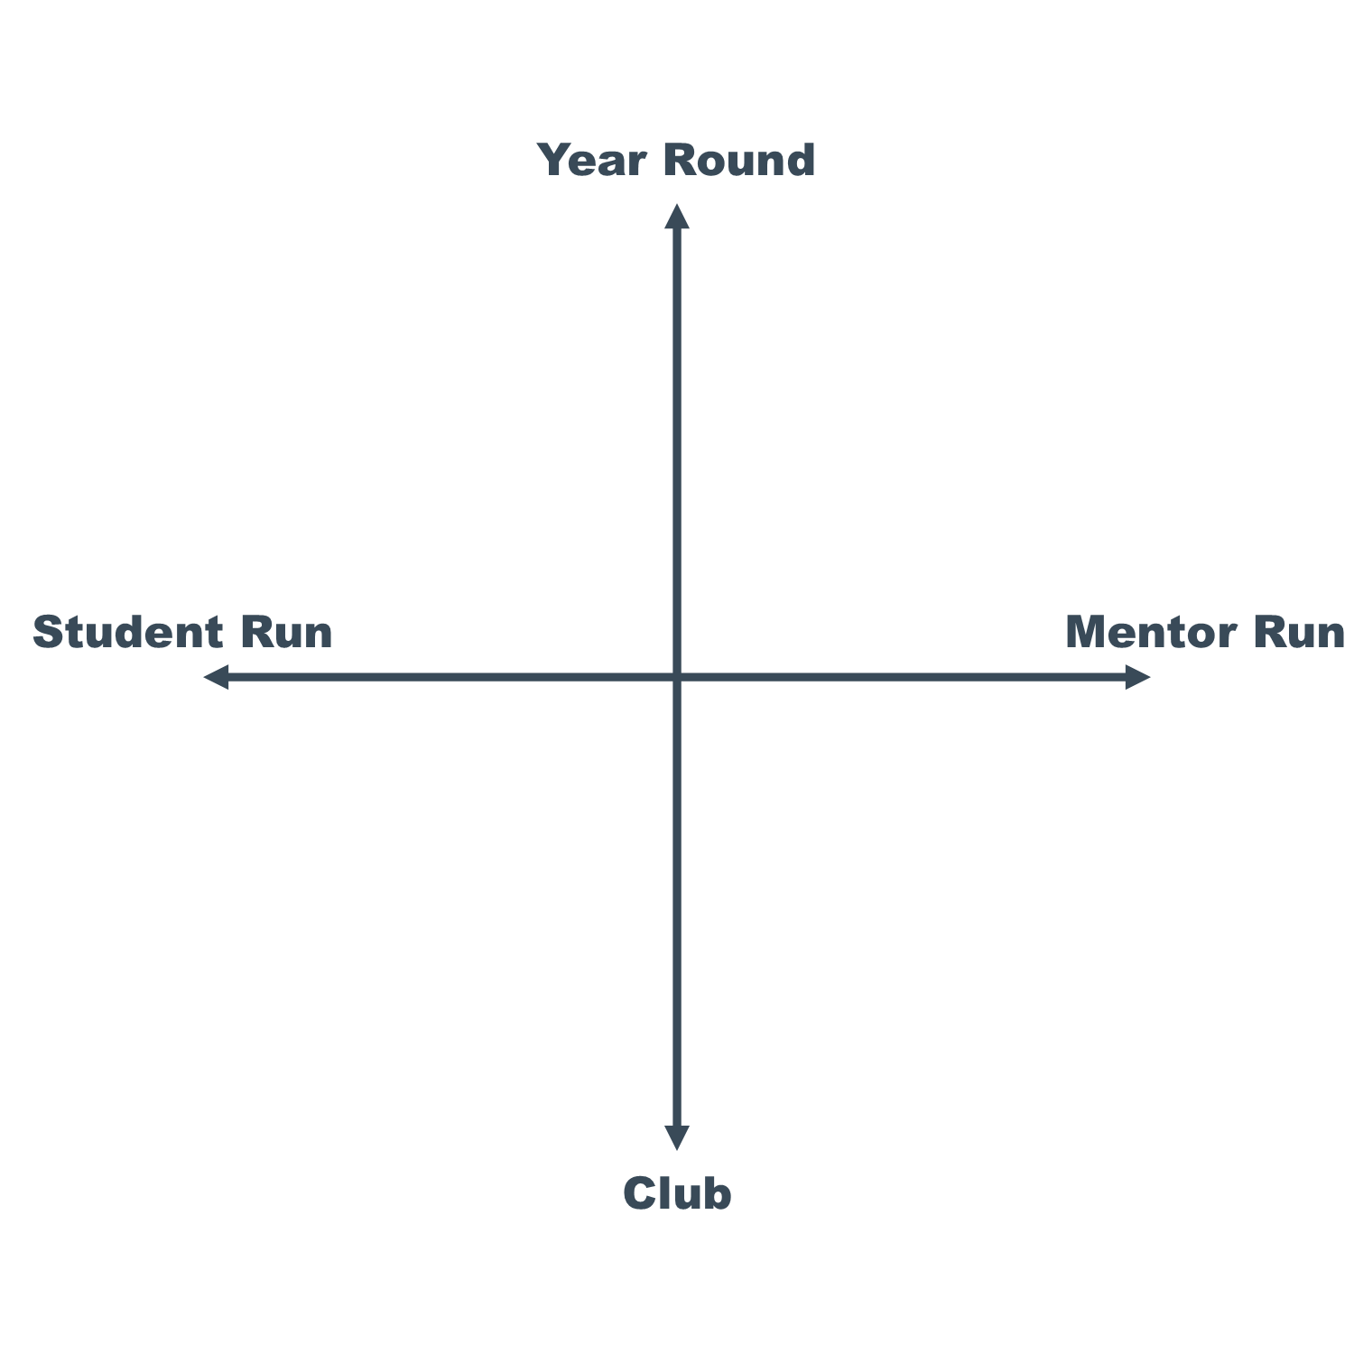
Organizational Spectrum
Where is your team?
Where do you want your team?

Slide 7
Organizational Charts
Having a clear hierarchy minimizes conflicts between students and mentors
Can be adjusted to meet your team’s needs each year

Slide 8
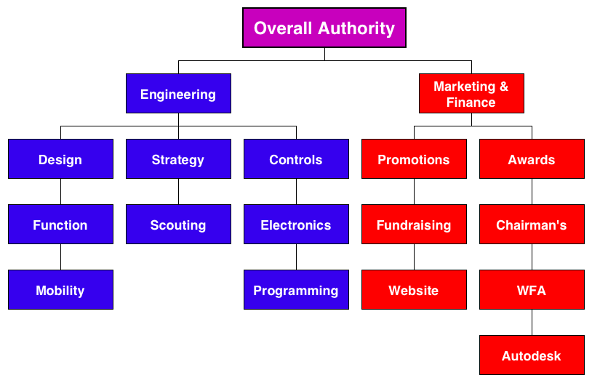
1114 Organizational Chart

Slide 9
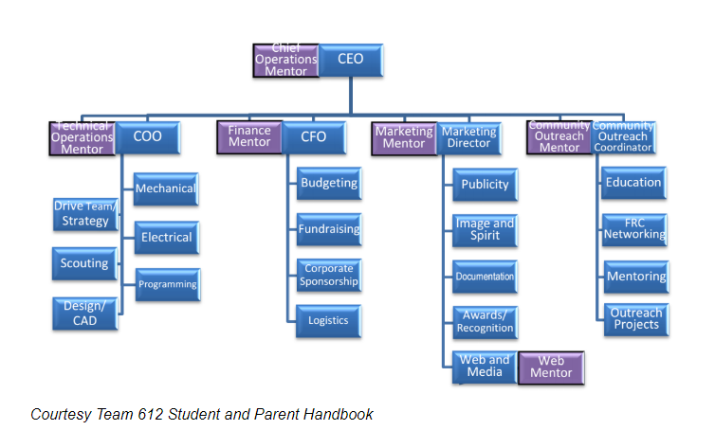
612 Organizational Chart

Slide 10
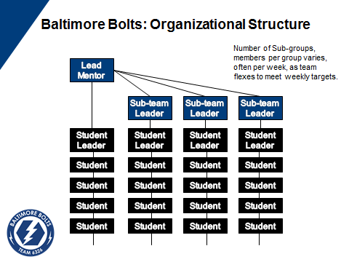
6326 Organizational Chart

Slide 11
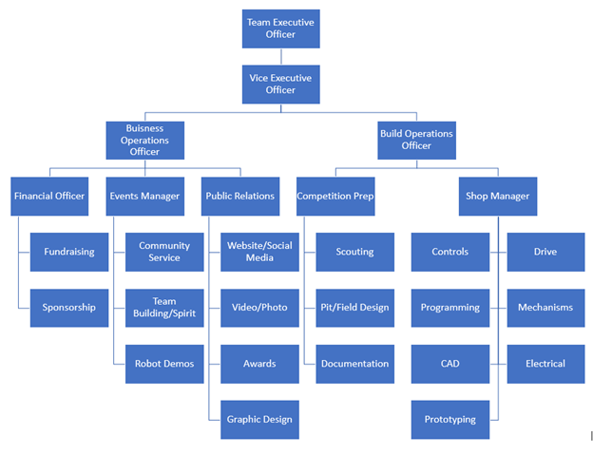
Old 1111 Organizational Chart

Slide 12
Current 1111 Organizational Chart

Slide 13
Leadership Structure
Chief Executive Officer
Oversees all operations of the organization
Ensures sustainability and future of the team
Chief Operating Officer
Works side by side with CEO to carry out their plans
Creates and maintains all team data

Slide 14
Leadership Structure
Business Director
Maintains team brand, business plan, budget, and fundraising activities
Build Systems Lead
Organizes robot construction
Organizes any other build work that needs to be done
Director of Education
Focuses on maintaining training materials for team
Collaborates with community organizations to provide training and outreach

Slide 15
Build Subteams
Fabrication
Creates drivetrain
Build bumpers and robot mechanisms
Build mock field components for testing
Maintain and upgrade practice robot
Wire and integrate electrical systems

Slide 16
Build Subteams
Controls
Coordinates design of controls system
Programs the robot
Integrates sensors

Slide 17
Build Subteams
Design
Implements the design of robots
Manages CAD of robot
Digitally design and test robot

Slide 18
Business Subteams
Public Relations
Photo
Photograph and document all team events
Release photos on social media
Video
Record and document team events
Creates videos for team events and awards
Graphics
Maintain and create team graphics and print media
Awards
Organize and create award submissions

Slide 19
Business Subteams
Events
Plan and coordinate community service events
Connect with sponsors for robot demos
Plan team events and organize volunteers
Coordinate travel arrangements for field trips

Slide 20
Business Subteams
Finance
Maintains and communicates team budget
Invite new sponsors
Maintain relationships with new and existing sponsors
Plan fundraising events

Slide 21
Team Organization Tips
You don’t have to have subteams for each area
Decide which subteams are necessary based on the amount of students and mentors on your team
Apply for awards that are applicable for your team
Don’t bite off more than you can chew
Don’t do something just for an award, do it for your team
Expand the focus of your team
It’s not all about build
Encouraging multiple skill sets will make your team more successful
The robot is just a tool for inspiration

Slide 22
Preparing for Build Season
Train students before build season begins
Inventory / order stuff
Fix machines
Do outreach events
Recruit mentors / students
Start awards
Chairman’s essay should be finished
WFFA should be finished
Entrepreneurship should be started / finished

Slide 23
Managing Build Season
Large project with a hard deadline
Have a plan and schedule
Perfectionism can call the schedule
Communication is key to staying organized
Trello/Slack
Must be able to effectively manage your time
Gantt chart
Leave time to test
Don’t forget about non robot tasks
Awards
Pit set up

Slide 24
Managing Competition Season
At Competition:
One representative in charge of strategy
Drive team should focus on driving
Train students in their respective roles
Pit students
Scouting students
Other roles
After Competition:
Meet as a team to debrief and review strategy
Review mistakes so you can do better at the next one

Slide 25
Your Post-Season
Keep meeting as a team
Work on outreach projects
Review design flaws
Recruit new team members
Summer trainings for new members

Slide 26
Questions?

