Slide 1
Surviving Inspection
MRA Education Day October 27, 2018
Presented by
Kevin Genson
kgenson@firstchesapeake.org
Senior Robot Inspector Chesapeake District

Slide 2
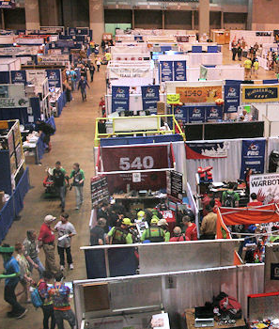
Agenda
Purpose and Goals
Event Flow
Inspection
Final Thoughts

Slide 3
Priorities and Goals
Robot Inspectors are your friends
Three Priorities
Safety
Compliance
Fun
Goals
Get all teams on the field for ALL matches
Teams must pass inspection to compete
Not being on the field hurts your own team and alliance partners
Help teams improve their robots

Slide 4
Pre-Inspections
FIRST allows lead robot inspectors (LRIs) to conduct pre-inspections.
Opportunity for teams to discover potential problems and solve them during unbag time.
Do not impact inspections during events.
FIRST Chesapeake will be doing pre-inspection events again on February 23, 2019.
Manassas
Richmond
Newport News
Maryland (Location TBD)
Additional pre-inspections may occur if depending on team needs (e-mail me).

Slide 5
Pre-Inspections
LRIs will be available during established times at each location.
Students are not required for pre-inspections.
Process:
Inspector greets you.
Robot is unbagged.
Inspector evaluates robot and provides recommendations.
Robot is bagged.
Do not unbag the robot unless authorized.
No work will be permitted on the robot during inspection.

Slide 6
District Event Flow
Day 1 (6:00PM-10:00PM)
Pits Open: load-in and teams set-up pits
Bag & Tag Compliance checks and unbagging of robots
Inspection can begin immediately!
Day 2 (Qualification matches start at 11:00AM)
Finish any last inspections (goal is to have none!)
“Random” inspections throughout the day
Re-inspections when asked
Day 3
“Random” inspections and re-inspections
Re-inspection for playoff robots

Slide 7
Championship Event Flow
Wednesday (5:00PM-9:00PM)
Pits Open and teams set-up pits
Bag & Tag Compliance checks and unbagging of robots
Inspection can begin immediately!
Thursday
Finish any last inspections (goal is to have none!)
Practice matches (10:00AM-12:30PM)
Qualification Matches start at 2:00PM
Friday & Saturday
“Random” inspections throughout the day
Re-inspections when asked
Weigh-in for playoff robots (Saturday)

Slide 8
Key Points
Start Inspection Early
Locate major problems early
Easier to get improvements/changes re-inspected
Once passed, can utilize standby practice line
Inspectors
Help and guide teams through the inspection process
Want to speak primarily to students
Getting Started
Send a representative to the inspection station and ask to be inspected.
Do not just bring your robot to be weighed

Slide 9
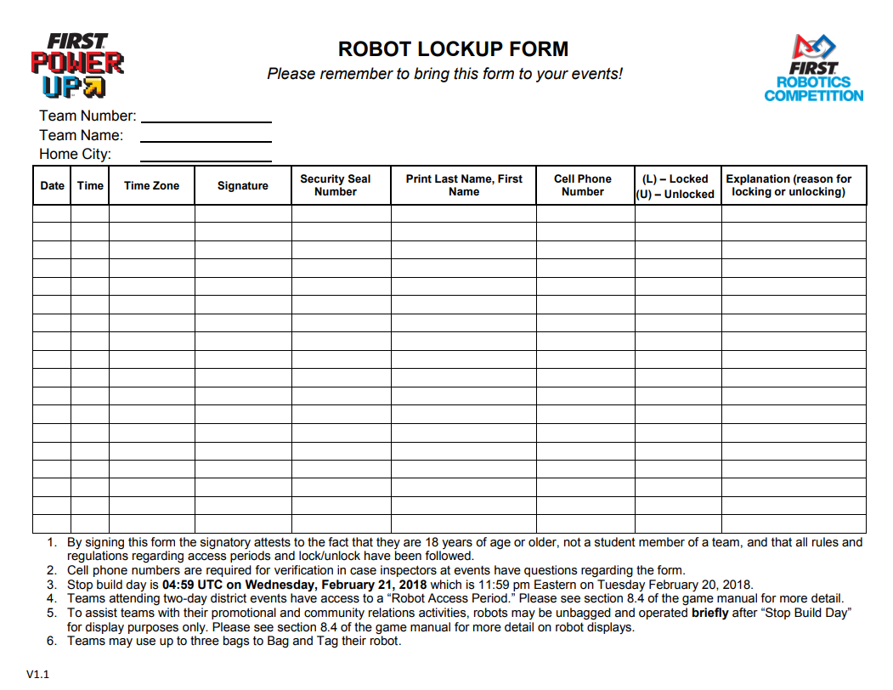
Bag-Tag Forms
Take a picture of your lock-up form every time you bag the robot.
Inspectors are not required to physically hold or sign the form, only verify that your team followed procedures and that everything is properly documented.

Slide 10
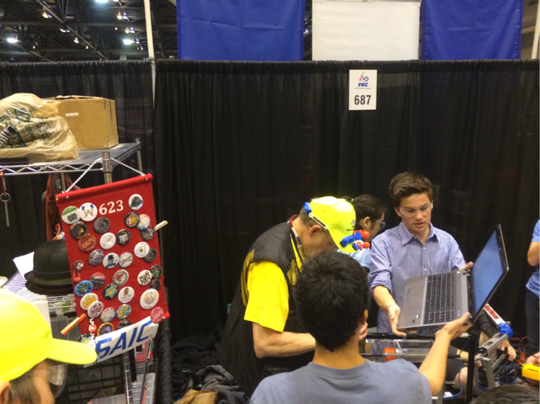
Initial Inspection

Slide 11
Unbagging
DO NOT UNBAG YOUR ROBOT UNTIL AUTHORIZED
You will be forced to stop and will likely have to wait several hours
Make sure your bag-and-tag form is signed and ready as soon as you enter the pit
Inspectors will be eager to sign you out
Designate a team member as being responsible for the form
Take a picture of the form before you leave
Do not put the form inside the bag
If you are found to be noncompliant, the LRI will have to get several signatures and this takes time.
Repeat offenders will require that I notify FIRST HQ and establish penalties.
This can be up to losing an entire day of unbag time.

Slide 12
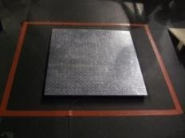
Initial Inspection
Weight
Robot
Remove battery and bumpers
Include all robot mechanisms
Bumpers
Weigh each set individually
Include all mounting hardware
Team places items on scale
DO NOT STEP ON SCALE
Size
Remove bumpers
Inspection method varies over years

Slide 13
Initial Inspection
Continue in Pit
Minimize representatives in pit
Prefer 2 key students
Ensure all stored energy in lowest energy state
Turn off robot
Relieve pressures (i.e., air in storage tanks)
Release springs / surgical tubing / bungee cords, etc.
Team must prove robot is safe

Slide 14
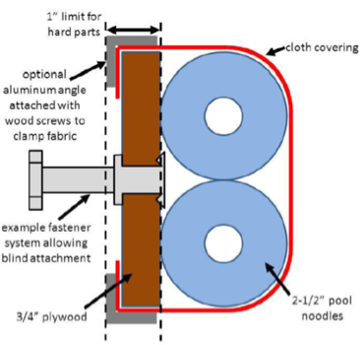
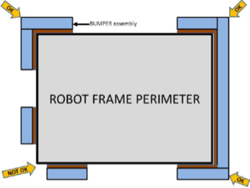
Bumpers
Bumpers (Red & Blue)
Construction
Proper plywood backing
Pool noodles
Durable fabric cover
Proper display of team number
Mounting
Securely fastened
Ease of removal
Pay particular attention to gaps
No gaps in corners
Minimum corner coverage

Slide 15
Bumpers
Bumpers are not an afterthought!
They are a mandatory part of the robot
Bumpers can easily disqualify a robot if not robustly constructed
Design and build early in the build period
Robust design that can withstand impact
Easy and intuitive mounting system
Double-check corners for no gaps
Avoid bumper covers or convertible bumpers

Slide 16
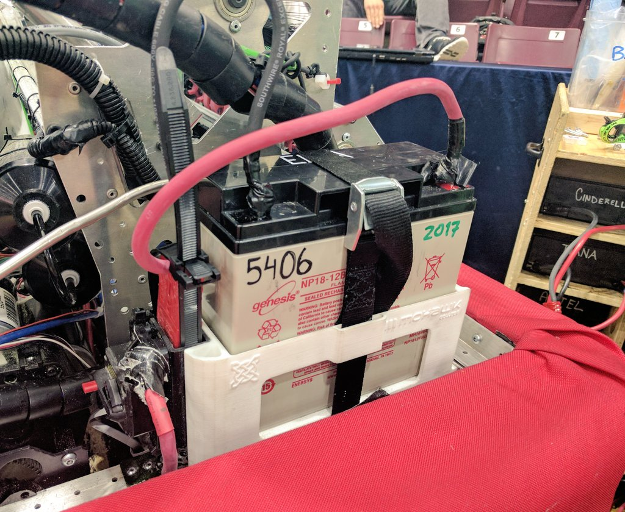
Mechanical Inspection

Slide 17
Mechanical Inspection
Bill of Materials (BOM)
Please have one ready
Total cost of materials <= limit
Total cost of any one component <= limit
KOP components excluded
Typically a lower limit for excludable components
Cost = Material + Labor
Labor from team members and recognized team sponsors are excluded
Can be provided in printed or electronic form
Put a copy on Google Drive or take a picture

Slide 18
Mechanical Inspection
Sharp Edges and Protrusions
Hazard to personnel or field
Leading edges of the robot (surface area of at least 1 in²)
Edges (minimum radius of 0.030)
Points and corners (minimum radius of 1/8-inch)
Undersides
Improperly cut tie-wraps
Areas of concern
Robot parts that interact with game pieces
Near 120 amp breaker
Near battery connections

Slide 19
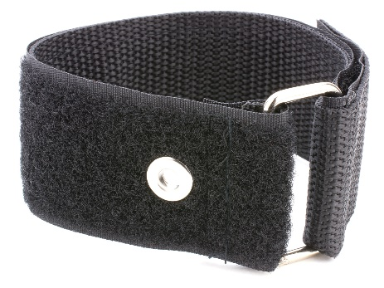
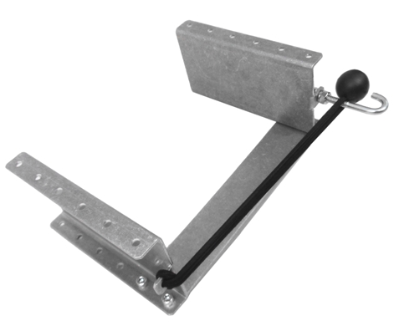
Mechanical Inspection
Safe Energy Storage
One approved battery
2018 rules allowed certain USB power packs.
Springs, surgical tubing, bungee cords, etc.
Pressurized air in storage tanks
Stored mechanical energy must be safe to be around
Consider who will be working around the devices
Teams must prove that their designs are safe
Securing Batteries
Battery must be secure (turn the robot upside down and shake it)
2” cinch strap (left) works well
Recommend avoiding the use of electrical energy storage that could stay charged after the robot is shut down (supercaps)
2” Cinch Strap (Amazon)
Battery Tray for AM14U Series (am-2939)

Slide 20
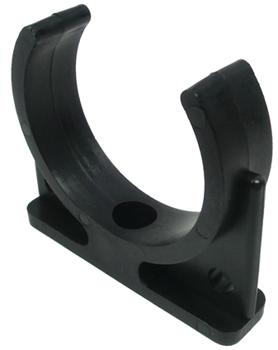
Mechanical Inspection
Pneumatic Storage
Storage tanks must be rigidly secured
Please avoid cable ties or tape
Cable ties are legal but rarely secure tanks well and can stretch over time
Tape is illegal on pneumatic components
Avoid using banding that could cut into the storage device
Preferred method are clamps or brackets
Consider using something other than a Clippard tank if you require a lot of air
Bracket for Plastic Air Tank
(am-2008)
0.89 Gallon Aluminum Tank
(Lowriderdepot.com)

Slide 21
Mechanical Recommendations
Clip your cable ties as short as you can get them
Run your hands over every part of the robot and file down accordingly
Ensure your battery is secure but easy to remove
Constrained in every direction
Minimal movement
Properly secure pneumatic storage
COTS solutions are preferred
Clamping is better than cable ties
If the storage tank can move it will undergo scrutiny

Slide 22
Mechanical Recommendations
If ballast is used, it must be in compliance with the rules
No additional batteries
Must not pose a threat to personnel, field, or other robots
No exposed lead (uncoated dive weights)
Avoid containers of loose fasteners or ballast
Ballast must be secured to the robot
Containers of loose material will undergo particular scrutiny

Slide 23
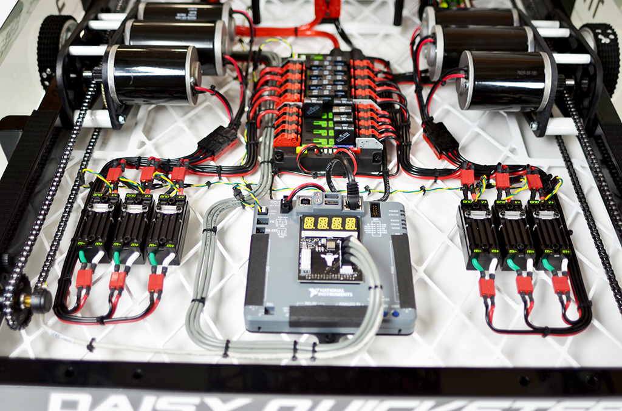
Electrical Inspection

Slide 24
Electrical Inspection
Breaker visibility is extremely important
Robots have escaped the field
Imagine you’re a stranger with seconds to disable a robot
Can you find the breaker?
Can you disable it?
Design for access and provide plenty of signage
Labeling not required but highly recommended
Ask a total stranger to turn off your robot and see what they do
Consider potential for other robots and game pieces to disable breakers

Slide 25
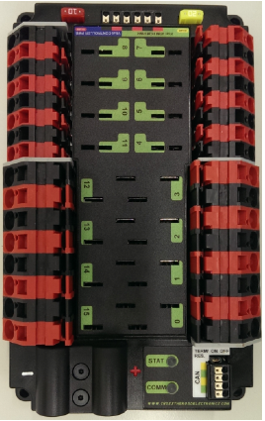
Electrical Inspection
Robot Radio
Make it a priority to get the radio programmed immediately
Mount the radio high and away from metal
Avoid clamping the radio (cable ties)
Use adhesive hook-and-loop tape
Radios power has been a source of issues
Secure connections with tape or adhesive
Consider Power Over Ethernet (POE)
Can use both POE and plug
Power Distribution Panel
Must be visible for inspection
Accessibility is key for good design

Slide 26
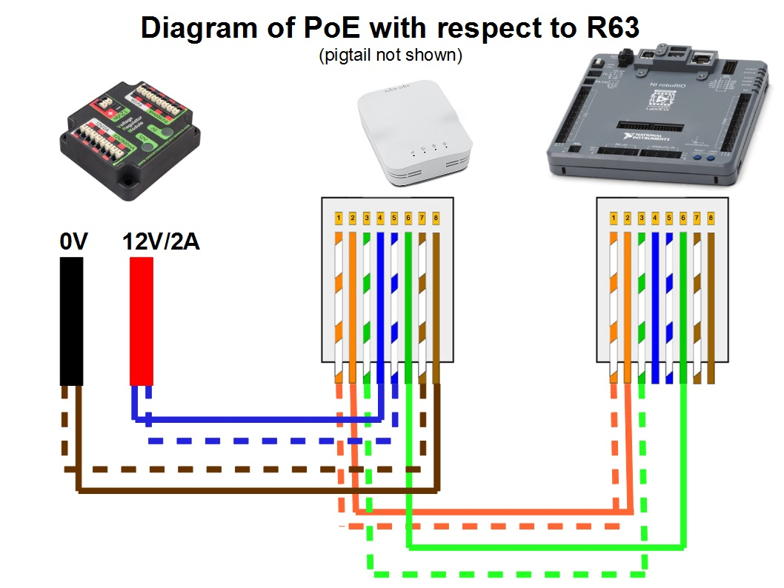
Electrical Inspection
https://www.chiefdelphi.com/forums/showpost.php?p=1694886&postcount=286

Slide 27
Electrical Inspection
A CUSTOM CIRCUIT is any electrical COMPONENT of the ROBOT other than motors, pneumatic solenoids, roboRIO, PDP, PCM, VRM, RSL, 120A breaker, motor controllers, relay modules, wireless bridge, or batteries.
Any active electrical item that is not an actuator or core Control System item
CUSTOM CIRCUITS shall not produce voltages exceeding 24V
Can’t directly alter power pathways
High impedance voltage monitoring or low impedance current monitoring acceptable
Can’t directly control motor controllers or relays
Can be connected to the CAN bus
CUSTOM CIRCUITS shall not interfere with, alter, or block communications among the roboRIO, PDP, PCM, and motor controllers
All remote cameras that broadcast a signal (e.g., use WiFi) used have to be pre-approved by FIRST

Slide 28
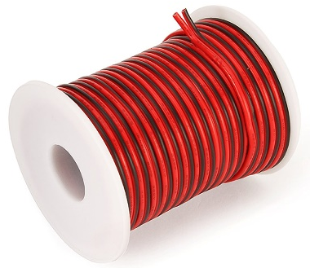
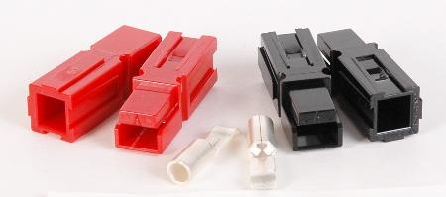
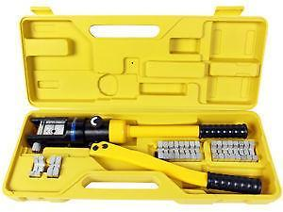
Electrical Recommendations
The best thing you can do is have clean, well-labeled wiring
Easy inspections
Easy troubleshooting
Use quality connectors such as Anderson Powerpole
Consider using larger gauge wire
10 gauge for motors
“Easy-ID Low Voltage Cable”
4 gauge for battery
“Ultra-Flexible Battery Wire”
Pull on every connection and verify nothing is loose
Consider using perforated sheets for electrical mounting
“High-Strength PVC Plastic Perforated Sheets”
Consider investing in a hydraulic crimper

Slide 29
Electrical Recommendations
Avoid making assumptions when it comes to motors, solenoids, or custom circuits
Use the FRC Q&A System
Feel free to contact me ahead of time for additional clarification
Pre-inspections are great for this
A good example is “automotive motors”
Will require evidence that the motor is actually for automotive use
Avoid using any kind of clamping action to secure your radio
This can cause the radio to have intermittent connectivity due to how the antenna is located inside the casing.
One solution that seems to work well is to use sticky-backed hook/loop tape such as 3M Dual Lock.
Examine the location of your circuit breaker and think about what is the potential risk of a field element (or another robot) accidentally turning your robot off.

Slide 30
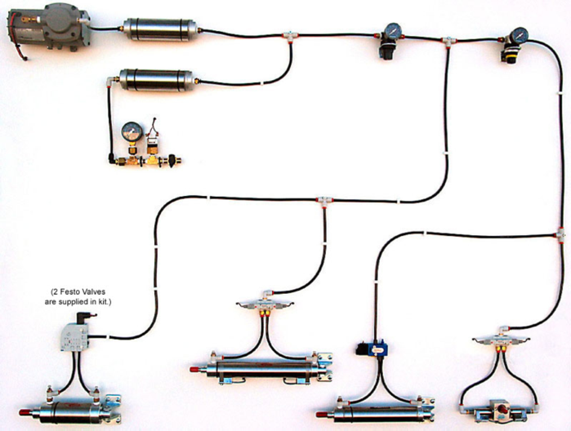
Pneumatics Inspection
Pneumatics

Slide 31
Pneumatics Inspection
Minimum Components
Pressure gauge to show the “stored” air pressure (<= 120 psi)
Pressure gauge to show the “working” air pressure (<= 60 psi)
A Pressure Relief Valve calibrated to release at 125 psi as close to compressor as possible
Prefer a rigid connection to compressor
A Pressure Switch connected to the Pneumatics Control Module and calibrated (<= 120 psi)
A Vent Plug Valve that vents the stored air to atmosphere
Should be easily accessible
Must vent “high side” of system to atmosphere
Pressure Relieving Regulator to relieve back-pressure from devices and maintain a 60 psi “working” pressure

Slide 32
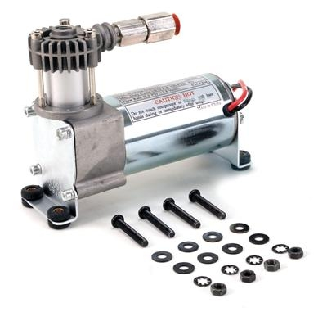
Pneumatics Inspection
No modifications to components except:
Remove mounting pin from cylinder
Wiring modified to connect to control system
Do not paint or tape over components
Compressor
Any type allowed if meet specs
Teams need to show documentation
KOP compressor is actually undersized
0.88 cfm vs 1.10 cfm limit
Only one can be used
Can be off-board
Must still be controlled by robot
Minimal pneumatics must still be on robot

Slide 33
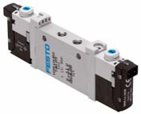
Pneumatics Inspection
Pneumatic Solenoid Valves
Non-KOP Solenoid valves are restricted to 1/8” NPT port diameters
Teams need to provide documentation
If solenoid valves rated below 125 psi are used, an additional pressure relief valve must be added to the “working” pressure circuit and set to a lower pressure than the valve rating
Only one solenoid per pneumatic actuator
Controlled by Spike relay or NI 9472 Digital Output module

Slide 34
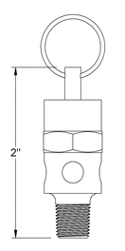
Pneumatics Recommendation
Perform your own pneumatics check
Check the high pressure gauge shows <= 120 psi
Check the working pressure gauge shows <=60 psi
Compressor should stop at 120 psi or less
Check operation of pneumatics relief valve
Short the leads of the switch
Make sure relief valve relieves at no more than 125 psi
Static pressure relief valve (right) superior option
Treat pneumatics like an electrical system
Cleanly lay out and label your tubing
The easier it is to inspect, the easier it is to troubleshoot
Simplify as much as possible (the tank on the right is equivalent to 6 Clippard tanks)
Ensure your gauges, regulators, dump valve, relief valve, and switch are easily accessible
The AndyMark 1.1CFM compressor can get hot enough to melt tubing.
Pressure Relief Valve
(McMaster-Carr 48435K714)

Slide 35
Pneumatics Inspection
White Clippard P/N: AVT-PP-41
Threaded End
Not Allowed !!

Slide 36
Follow-On Inspections
Have inspectors re-certify all changes to the Robot, with the exception of:
Adding/removing fasteners or labeling
Changes to code
Replacement of components and mechanisms with identical units
Additions, removals, or reconfigurations of robot with previously inspected subsets of mechanisms
When in doubt, ask.

Slide 37
Disputes
Unfortunately there will be disagreements.
If you disagree with the ruling of an inspector, please contact the LRI (or the RI may do so)
RIs are responsible for inspecting robots
LRIs are responsible for customer service
If you disagree with the LRI, you have the right to escalate the dispute to the SRI (me)
The LRI will contact me directly
If you disagree with me, you have the right to request that I contact Al Skierkiewicz, FRC Chief Robot Inspector
I will coordinate with Al and get a final ruling
This is not likely to be a fast process
If you disagree with Al, too bad.

Slide 38
Design Recommendations
Do not assume the field is perfectly engineered
Broken ropes in 2016
Field elements getting damaged or bent during play
It may be the field’s fault, but it’s still your problem
A simple robot that works perfectly is better than a complicated robot that can’t be trusted
Design your robot as if everyone is out to destroy you
Emphasize ruggedness and survivability
Design for reliability and repair

Slide 39
Questions?
kgenson@firstchesapeake.org

