Slide 1
Manipulators 101
Tom Milnes
Team 2199 “Robo-Lions” Systems Mentor
Principal Mathematician JHU/APL
Notes:
Introduction by Mr. Milnes

Slide 2
What is a Manipulator?
A mechanism or mechanisms that manipulate game pieces or allow alliance robots to score points (offense) and/or prevent your opponents from scoring points (defense)

Slide 3
Scoring Points
Normally a primary method
2017 – Steamworks – Placing gears to move rotor
2016 – Stronghold – Driving Through Obstacles
2015 – Recycle Rush – Stacking Crates
2014 – Aerial Assist – Throwing or pushing balls
2013 – Ultimate Ascent – Shooting frisbees into goals
2012 – Rebound Rumble – Shooting basketballs into hoops
2011 – Logomotion – Hanging inner tubes on rings

Slide 4
Scoring Points
And at least a secondary method
2017 – Steamworks – Climbing Airship
2016 – Stronghold – Scoring boulders / Climbing
2015 – Recycle Rush – Placing trash barrel on stack
2014 – Aerial Assist – Passing balls to alliance partners
2013 – Ultimate Ascent – Climbing a Pyramid
2012 – Balancing on Teter-Toter
2011 – Deploying minibot to climb a tower

Slide 5
Scoring Points
Perhaps a third method
2017 – Steamworks – Shooting Balls into Boiler
2016 – Stronghold – Climbing Tower

Slide 6
Typical Activities for Scoring
Grabbing and releasing on object
Lifting an object or robot
Shooting an object
Placing an object

Slide 7
Typical Activities for Defense
Blocking an object from scoring
Blocking a robot from moving to scoring position

Slide 8
Offense or Defense?
Offense is generally more important than defense
But being to do both is even better
Don’t build a purely defensive robot
But think how to add defensive capabilities
Unless alliances are separated like in 2015

Slide 9
Manipulator Design
Don’t reinvent the wheel!!
Research to find out if there is already a proven method!!
AndyMark presentations
http://files.andymark.com/ManiupulatorDesign.pdf
Watch “Robot In 3 Days” or “Build Blitz” after kickoff
Monitor Chief Delphi
http://www.chiefdelphi.com/forums/portal.php
KISS Principle
Keep It Simple but Sophisticated
As simple as possible while achieving all the required functionality

Slide 10
Grabbing Devices
Ball / Tube Grabbers
Rotating wheels or rollers are very successful

Slide 11
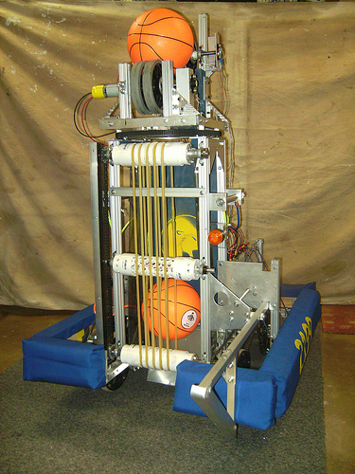
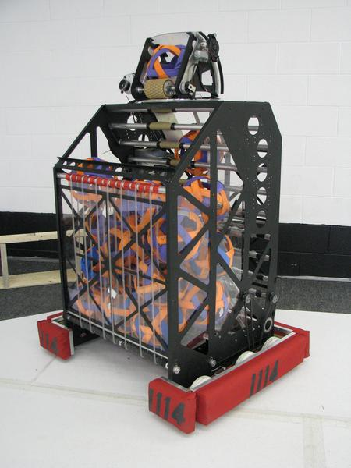
Ball / Tube Grabber
2012 Rebound Rumble
2009 Lunacy
2011 Logomotion

Slide 12
Ball / Tube Grabber
Trick to implementing a rotating wheel grabbing device
Make velocity at wheel exceed velocity of vehicle
Consider entrapping device vice wheel
Robot Velocity
Wheel
Velocity
XXXX

Slide 13
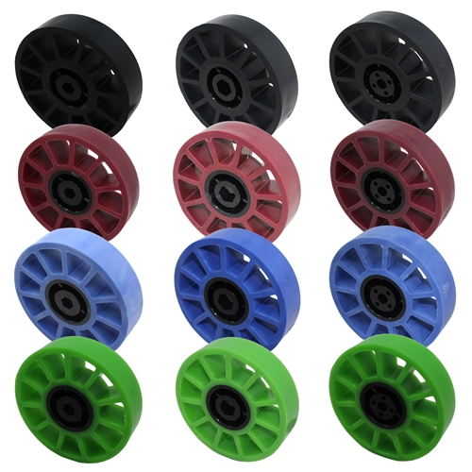
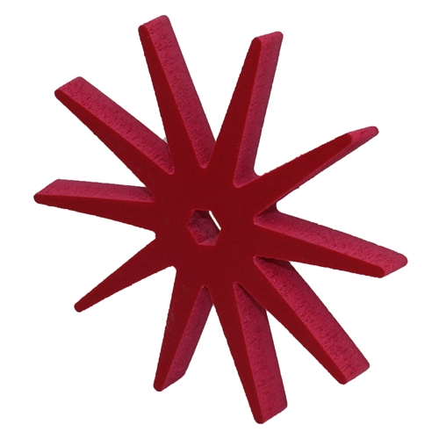
Entrapping Devices
AndyMark
Foam Entrapption Star
AndyMark
4” Compliant Wheels

Slide 14
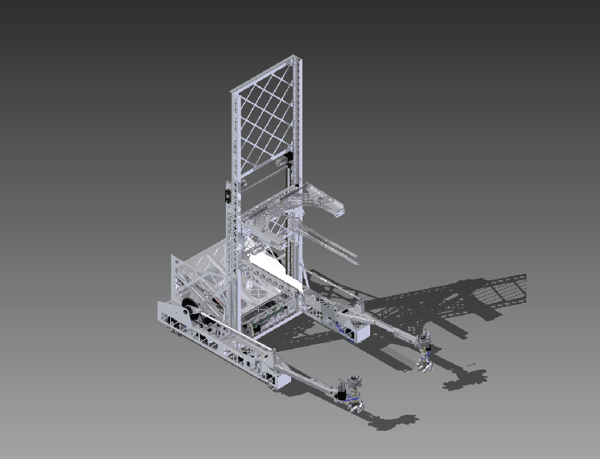
Crate Wheel Grabber

Slide 15
Grabbing Other Objects
It depends on the object!
Review designs from manipulator presentations
Review Robot In 3 Days and Build Blitz designs
Check Chief Delphi for good ideas
General Principles
If you only need fully open and fully closed then consider pneumatics
Otherwise consider using motors
Make sure grabbing surfaces are high friction
Apply rubber over bare metal
Keep It Simple but Sophisticated

Slide 16
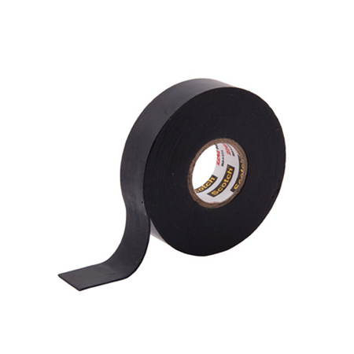
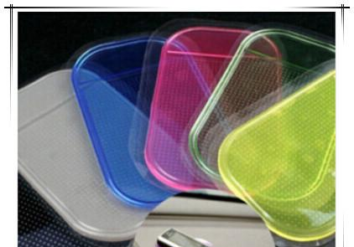
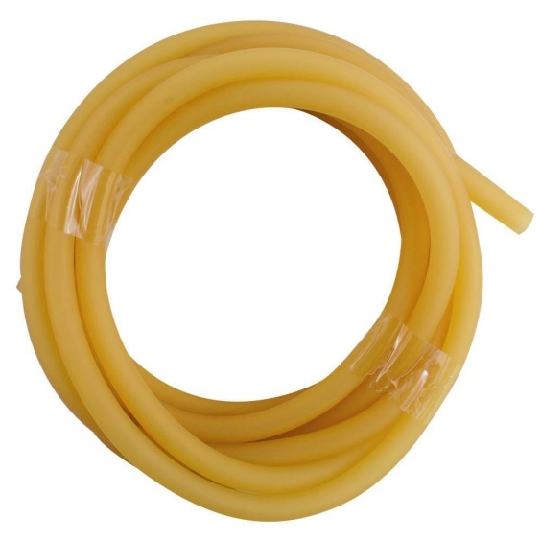
Gripping Aids
Surgical Tubing
$2 / foot at
Home Depot
Rubber Tape
$.5 / foot online
Gel Pad - $4.99
online

Slide 17
Throwing Balls
For small to mid sized balls rotating wheels or rollers make pretty good throwing devices
Also works for circular objects like frisbees
Two choices
Wheels / rollers on one side only
Wheels / rollers on two sides

Slide 18
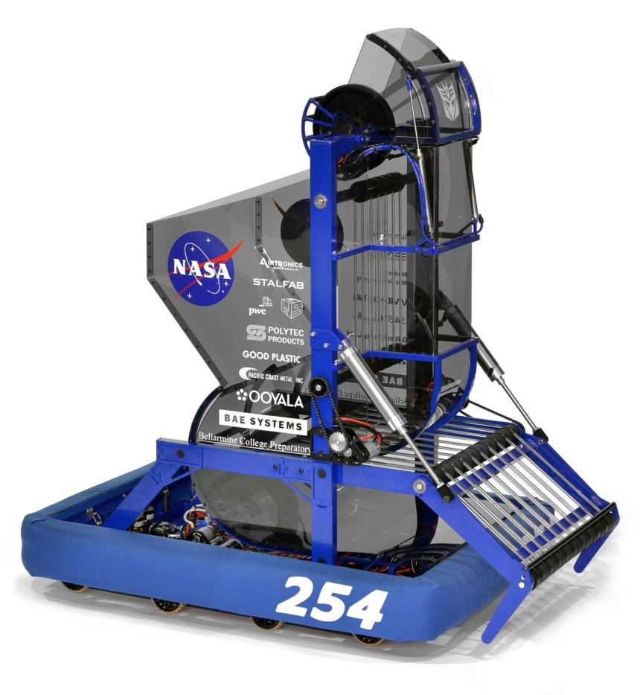
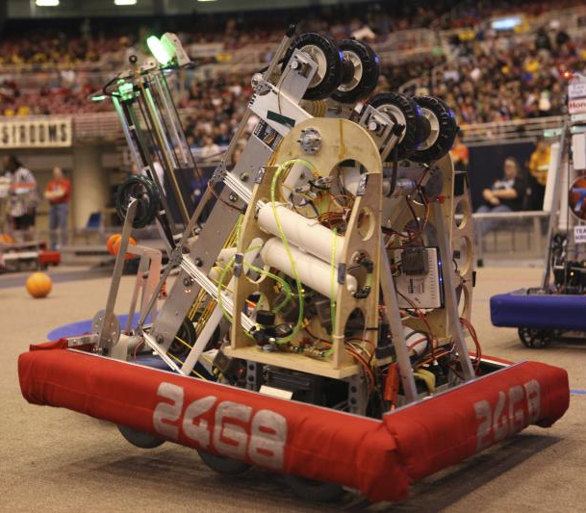
Small Ball Throwers
Single Sided Shooter
Double Sided Shooter

Slide 19
Single vs. Double Sided
Single Sided
Simpler
Often just one big wheel can be used
Opposite side can be a ball guide
Extreme amount of spin
Can be a good thing!
Limits translational velocity of ball ~1/2 that of wheel
Double Sided
More complicated
Can adjust amount of spin on ball
May require 3 or more wheels to “guide” ball
Higher translational velocity than single sided

Slide 20
Single vs. Double Sided
For 2012 Rebound Rumble (Nerf Ball shooter) and 2013 Ultimate Ascent (Frisbee shooter) the single sided shooters were the better choice
2012 – Underspin required to ensure ball went off backboard into the basket
2013 – Spin required for Frisbees to stabilize in flight

Slide 21
Large Ball Throwers
For Aerial Assist (2014) with large 24” medicine ball there weren’t many wheel shooters – Needed both torque and speed
Catapults (Stored elastic energy)
Rubber tubes store energy when drawn back
Mechanism needed to release immediately to achieve high velocity
Pneumatic Puncher
Mechanism needed to release immediately to achieve high velocity
Throwing Arm
Motors and gear boxes
Kickers
Motors and gear boxes

Slide 22
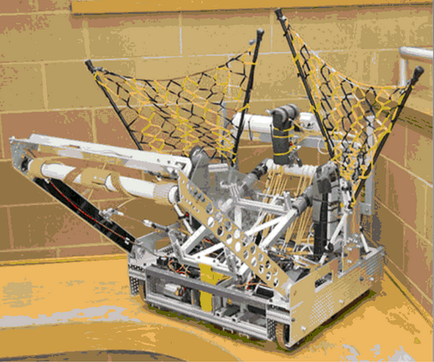
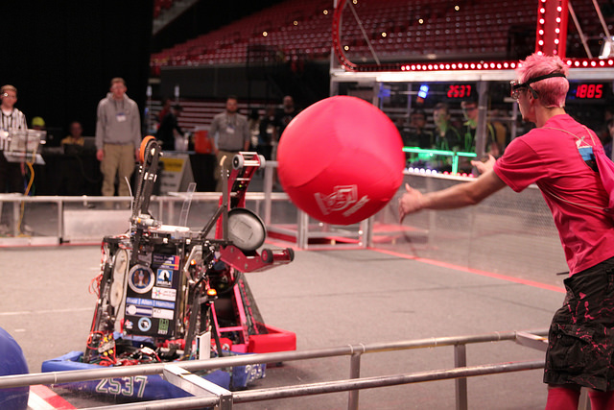
Large Ball Throwers
Elastic Catapult
Pneumatic Puncher

Slide 23
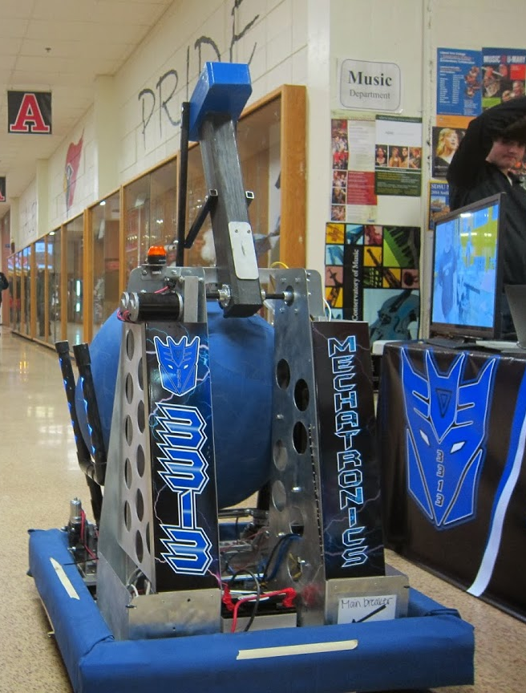
Large Ball Throwers
Throwing Arm
Kicking Mechanism

Slide 24
Object Lifting Mechanisms
Used when shooting an object into scoring position is impractical
Extension Lifts
Telescoping lift
Scissor lift
4 Bar Linkage

Slide 25
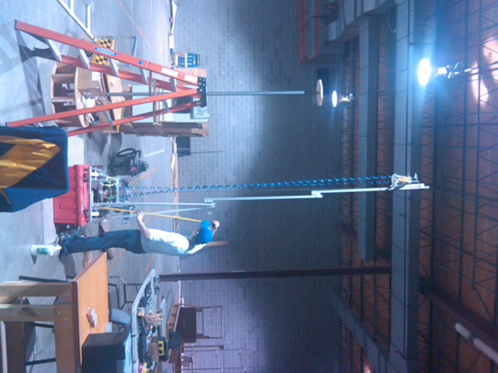
Telescoping Lift
Long members slide by each other to attain height

Slide 26
Telescoping Lift Types
Motor
Motor

Slide 27
Continuous Telescoping Lift
Goes up slowly compared to cascade lift
At chain / cable speed
Low tension on return chain / cable
May need tensioner device near return sprocket / pulley
Return
Sprocket / Pulley

Slide 28
Cascade Style 1
Return attached to first slider stage
Goes up quickly
N x Chain / Cable Speed
N = # of Stages
Lots of tension on lower stages
No return on final slider stage
May need bungie cord to cause final stage to come down
Stage 3
Stage 2
Stage 1

Slide 29
Cascade Style 2
Return attached to final slider stage
Goes up quickly
N x Cable / Chain Speed
Lots of tension on lower stages
Return moves faster than output
Complicated system
Different diameter spools?

Slide 30
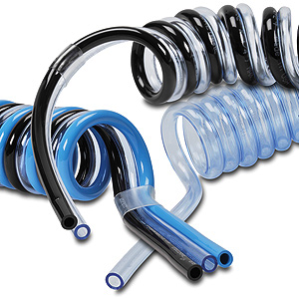
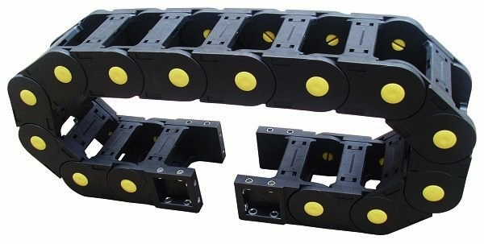
Telescoping Lift Manipulators
The manipulator at the top of the lift will either need air tubing or wiring to extend along with the lift
Air Tubing
Use spiral tubing
Wiring
Use cable carrier

Slide 31
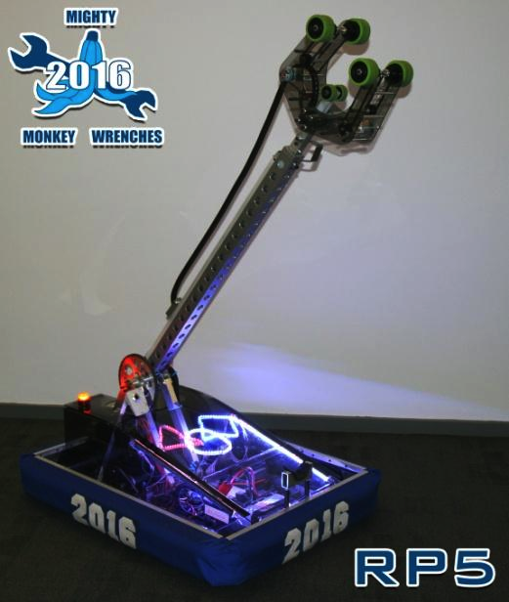
Telescoping Lift Manipulators
Spiral Tubing
Cable Carrier

Slide 32
Scissor Lift
Advantage
Minimum retracted height
Goes under field barriers
Disadvantages
Needs to be heavy to be stable
Must be built precisely
Doesn’t deal with side loads well
Becomes increasingly unstable with height
Loads very high initially

Slide 33
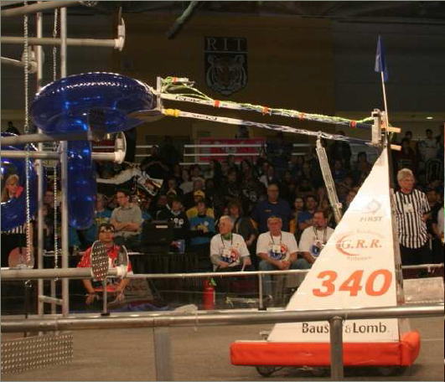
4 Bar Linkage

Slide 34
4 Bar Linkage
Very popular design
Pin / bolt loadings can be high!
Use SAE graded materials
Watch for buckling in lower member
Counterbalance arm if possible
Counterweight
Elastic counterbalance
Keep overall robot CG centered and as low as possible
Maximum height is limited

Slide 35
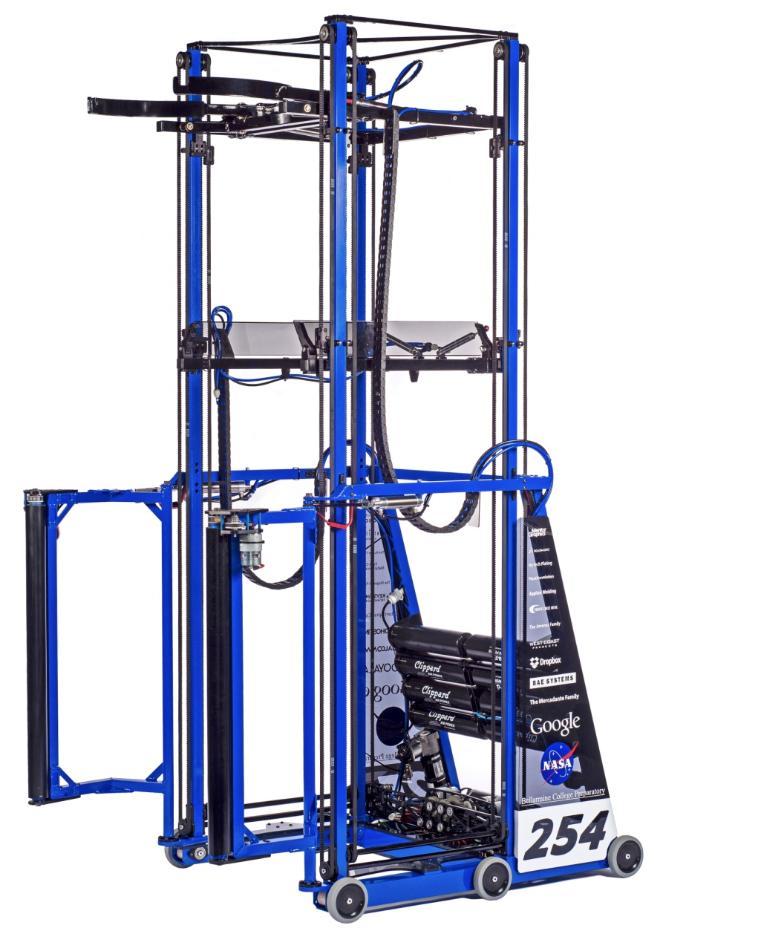
Crate Lifting Robot
Stacks from the bottom up
Robot surrounds crate
Single loop chain or belt lift
Unidirectional graspers
Engages from underneath
Slides by from the top
Spring actuated

Slide 36
Unidirectional Grabber
Spring
Pivot

Slide 37
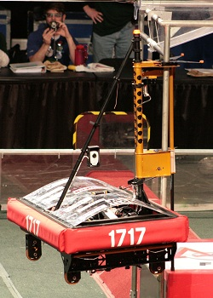
Robot Lifting Mechanisms
The ultimate lifting challenge
Up to 120 pounds of weight to overcome
To lift or not to lift?
Which way really gets more points?
Methods
Drive on
Pneumatic Lift
Motor Lift

Slide 38
To Lift or Not to Lift?
Robot lifting has never been the primary means to score points
Usually done at the end of the game for “bonus points”
Whether to Lift Depends on Point Values
2010 Game – Breakaway – 3 points
Not worth it!
Best robots concentrated on scoring soccer goals
2013 Game – Ultimate Ascent
10 points per level, 3 levels
Best robots scored as many frisbees as possible then climbed 1 level
2017 Game – Steamworks
50 points for a lift, absolutely essential

Slide 39
Drive On
If height is small consider driving on by using an incline ramp
Converts kinetic energy ½mv² to potential energy mgh
Ideal when 1” off the floor scores

Slide 40
Pneumatic Lift
Lifting is what pneumatics were made for
Force = Pressure x Area
Working Pressure
60 pounds / in² so…
2 in² will lift 120 pounds
Area = π(D/2)²
D – Diameter or “Bore Size”
Ideal for 6 – 18” lifts
D
“Bore Size”
S
t
r
o
k
e

Slide 41
Pneumatic Lift

Slide 42
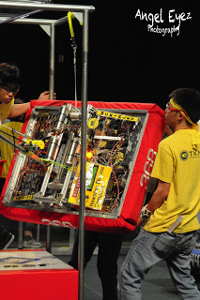
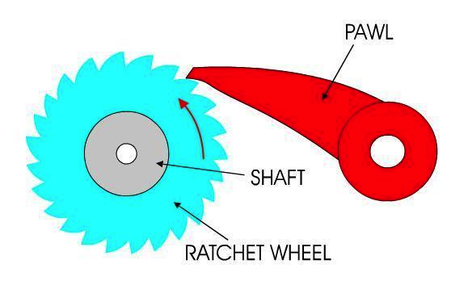
Motor Lift
Motor / Gearbox provides lifting force
Ratchet and Pawl recommended
Maintains height after power off
Prevents motor from overheating

Slide 43
Feeder Station
Usually scoring objects can be gotten from a feeder station or by other means
Feeder stations make sense when its quicker than other means to get scoring objects
Use Feeder Station
2017 Steamworks – Prevented Gear theft
2015 Recycle Rush – Easier to get crates without interfering trash
2013 Ultimate Ascent – Easier to get frisbees from station than off the floor
Don’t use Feeder Station
2011 – Logomotion – Inner Tubes reached robots more quickly by human players throwing them

Slide 44
Feeder Station
Best to continue feeder station into robot
Feeder
Station
XXXX
Robot

Slide 45
Sensors
Sensors can be critical to using manipulators successfully
Allows scoring in autonomous
Can give driver field awareness when blocked by field elements
Can make manipulator actions automatic

Slide 46
Summary
Manipulators are key to scoring or preventing an opponent from scoring
Don’t reinvent the wheel – check what has already been done
Presentations, Robot in 3 days, Chief Delphi
KISS Principle – Make it no more complicated than it needs to be!
Is there a simpler way to do this?
Add sensors to enable autonomous operation / provide field awareness / make proper manipulator actions automatic

